Slide 1

RAYS Capital Partners
The Global AI Engine
Why the Future of Computing Runs Through Taiwan
TEXPERS 2026 Annual Conference
August 2-4 2026 |

Slide 2





RAYS Capital Partners
Hardware Specialist
RAYS Capital is a Hong Kong-based boutique asset manager with close to two decades of specialized investment experience.
Pure-Play Hardware Specialist
The only Asia-based specialist focused exclusively on semiconductor and hardware equity across Asia and the US.
The Taiwan Supply Chain Niche
Our proprietary ecosystem network inside Taiwan provides a unique information edge for investing in global AI leaders.
“Winner Takes All” Philosophy
We identify the biggest structural beneficiaries of significant product upgrade cycles and deploy capital in a high-conviction manner.

Slide 3

RAYS Capital Partners
Taiwan's Moat: Strategic Hard Facts (1-5)
92% Dominance: Taiwan manufactures 92% of the world's most advanced sub-7nm logic chips.
90% Server Share: 9 in 10 global AI server systems are integrated by Taiwanese firms in 2026.
2-Hour Ecosystem: The entire supply chain from raw wafer to server rack exists within a compact 200km radius.
73% Foundry Lead: TSMC captures 73% of the global pure-play foundry market as of Q1 2026.
$250B US Pact: Historic 2026 agreement is in place for Taiwanese firms to invest $250B in US AI chip hubs.

Slide 4
RAYS Capital Partners
Taiwan's Moat: Strategic Hard Facts (6-10)
Yield Superiority: Taiwan's 3nm yields (~80%) are nearly double those of global rivals struggling around ~45-50%.
OSAT Monopoly: Taiwan controls 50%+ of the global Outsourced Semiconductor Assembly and Test market.
Capex Supremacy: In 2026, Taiwan’s tech sector aggregate Capex is set to exceed $55B, outspending all EU nations combined.
12,000+ Products: TSMC serves 530+ customers producing over 12,000 distinct silicon products annually.
2nm Supercycle: TSMC has guided a 70% CAGR for 2nm capacity growth starting in late 2026.

Slide 5




RAYS Capital Partners
The Strategic Hardware Flow
The AI network operates on Symmetric Interdependence. US firms provide the architectural "specs," while Taiwan provides the physical "substance."
1. Upstream (US)
2. Midstream (TW)
3. Downstream (TW)
4. End User
IP & Design
Nvidia, Apple, AMD, Broadcom
Manufacturing
TSMC (Foundry), ASE (Packaging)
Integration
Foxconn, Quanta, Wiwynn
Hyperscalers
Microsoft, Google, Meta, AWS

Slide 6


RAYS Capital Partners
Technological Edge: The Global Split
United States: "The Brain"
Taiwan: "The Nervous System"
Architecture leadership in GPUs and CPUs.
Unrivaled yield rates at 3nm and 2nm nodes.
EDA software tools (Synopsys/Cadence).
Scalable multi-die packaging (CoWoS).
Software ecosystem moats (CUDA).
Vertical system-on-chip integration.

Slide 7

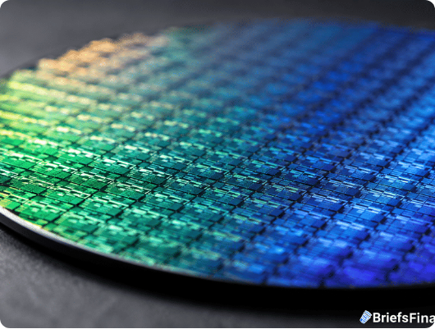



RAYS Capital Partners
The Unbridgeable Yield Gap
Advanced manufacturing isn't just about small nodes; it's about Yield Economics. A foundry with ~50% yield is an economic liability.
TSMC 2nm/3nm Yield
Intel 18A Node Yield
Note: For a $40,000 top-tier AI GPU, a 30% yield delta represents the entire corporate profit margin.

Slide 8
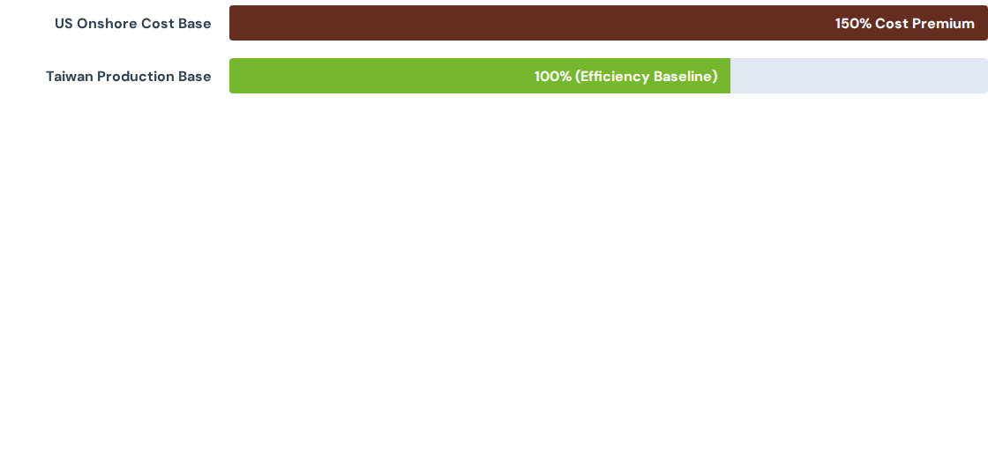

RAYS Capital Partners
Structural Barriers: Cost & Learning
~30%
THE COST PENALTY
Construction
US Fab construction is ~30% more expensive with 20% higher operational labor costs.
Density
Taiwan ecosystem is within 200km radius, enabling rapid 24/7 engineering cycles.
Resilience
Systemic capital efficiency in Taiwan allows US design firms to remain globally competitive.

Slide 9
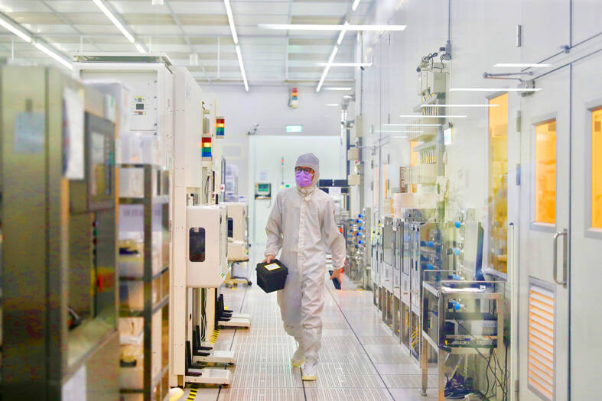

RAYS Capital Partners
Sub-sector: Foundry Dominance
Taiwanese foundries are the physical forge for nearly every US-designed AI chip.
TSMC: Manufacturing 92% of the world's sub-7nm logic for Nvidia and Apple Silicon.
UMC: Provider of critical power management ICs and automotive logic blocks.
Upstream Customers: Nvidia, Apple, AMD, Qualcomm.

Slide 10

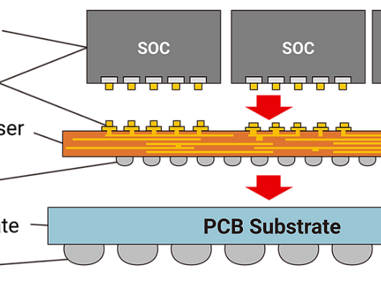

RAYS Capital Partners
Sub-sector: CoWoS Bottleneck
Advanced packaging is now the primary supply bottleneck for the global AI build-out.
ASE Global
World's largest OSAT provider. Essential partner for Nvidia's Blackwell series rack architecture.
KYEC
Dominant in high-speed validation and reliability testing for massive AI accelerators.
Upstream Customers: AMD, Tesla (Dojo), Broadcom.

Slide 11


RAYS Capital Partners
Sub-sector: AI Server Integration
Over 90% of global AI server systems are assembled by Taiwanese EMS groups.
Foxconn (Hon Hai): Assembles the bulk of Nvidia’s GB200 systems and high-density clusters.
Quanta & Wiwynn: Direct architectural partners for Amazon and Microsoft cloud deployments.
Upstream Customers: Amazon, Microsoft, Google.

Slide 12
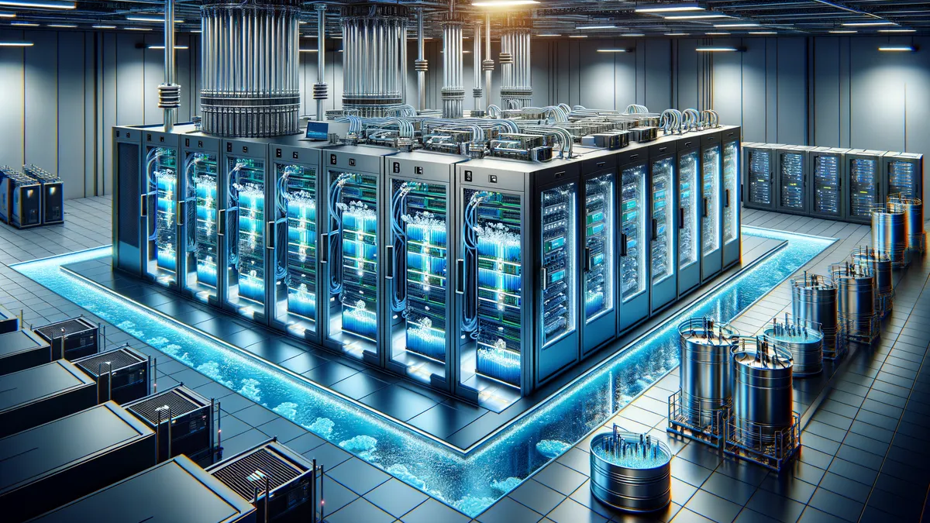
RAYS Capital Partners
Sub-sector: Infrastructure Backbone
The Cooling Imperative
AI GPUs generate unprecedented heat. Legacy air-cooling is failing; Liquid Cooling is the mandatory upgrade.
Delta Electronics: 50%+ market share in high-efficiency server power supplies.
AVC: Global leader in liquid cooling manifold blocks and cold plates.

Slide 13
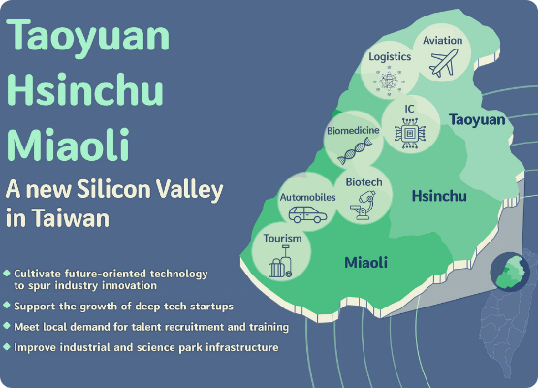
RAYS Capital Partners
The Silicon Shield: Reframing Risk
92%
Geopolitics & Portfolio Resilience
Advanced Chips share
“When an entire global economy relies on a single island to function, the risk of disruption becomes too expensive for the world to permit. In the AI era, interdependence is the ultimate deterrent”

Slide 14


RAYS Capital Partners Limited
Unit 1903-04, 08, 19/F, Nine Queen’s Road Central
Central, Hong Kong
Tel: (852) 3973 6700
Fax: (852) 3973 6799
Nicholas Chung
Partner / Investor Relations
(852) 3973 6738 / NChung@rayscapital.com

