Slide 1
A New Investment Era
Gina Sanchez
Chief Executive Officer
August 3, 2026

Slide 2
A New Investment Era
The End of an Era
Global Fragmentation
The Role of AI
Demographic Challenge
Debt Dynamics
Capital Markets Outlook

Slide 3
End of an Era

Slide 4
Fastest Population Doubling in History
Source: UN World Population Growth Prospects 2022
Notes:
In 1804, the world hit 1 billion people. In 1927, 123 years later, the world hit 2 billion people. In 1960, the world hit 3 billion people. In 1999, 39 years later, the world doubled to 6 billion people. The global population is not expected to double again.

Slide 5
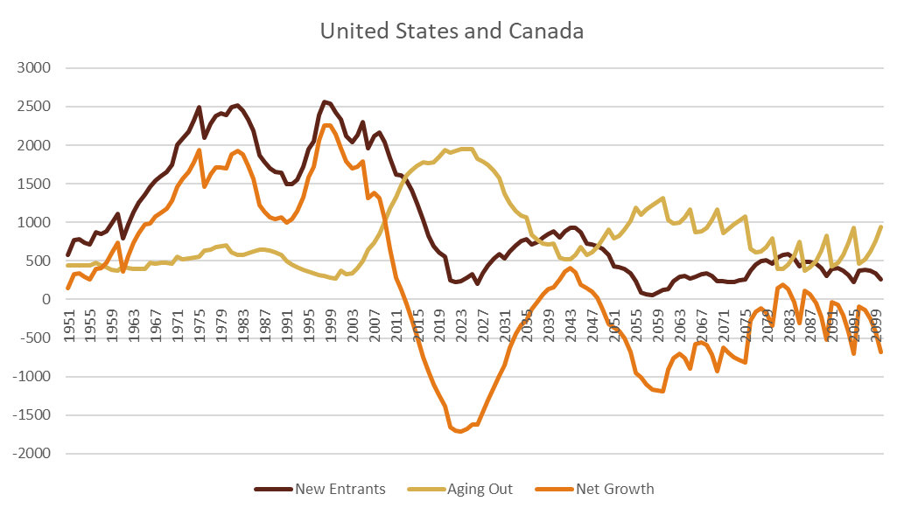
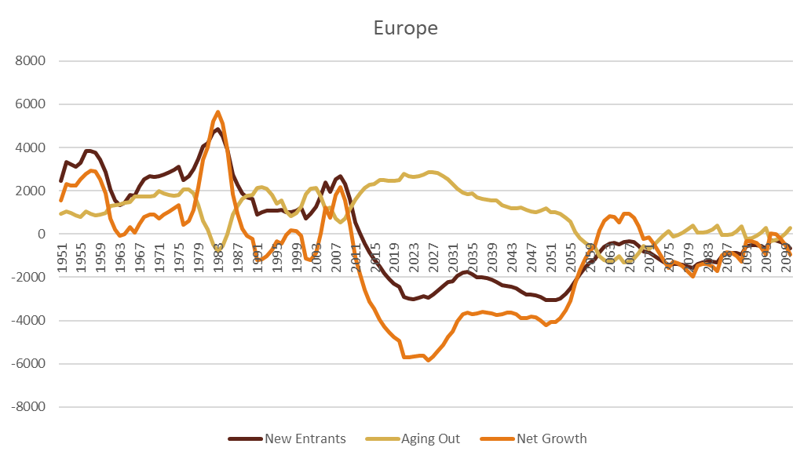
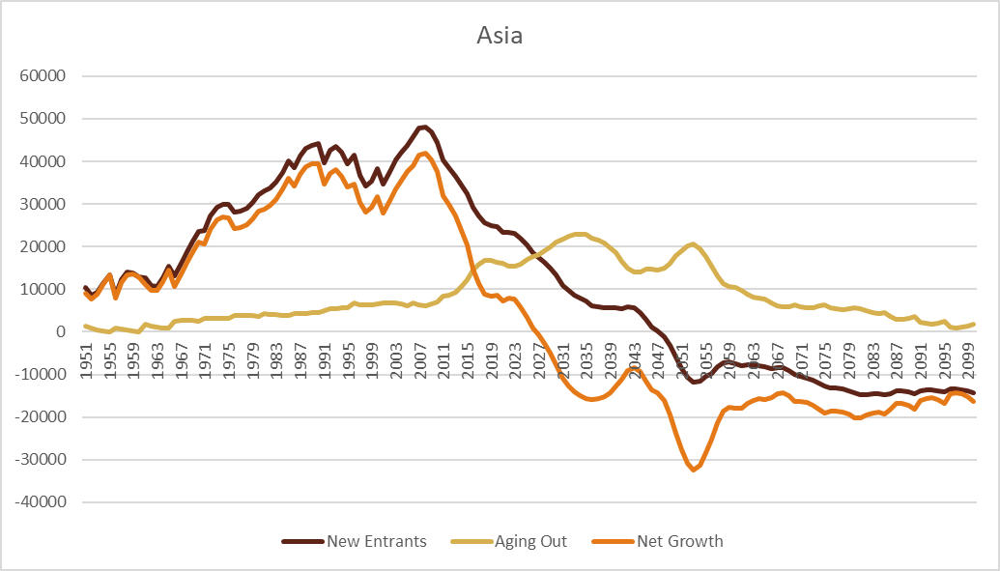
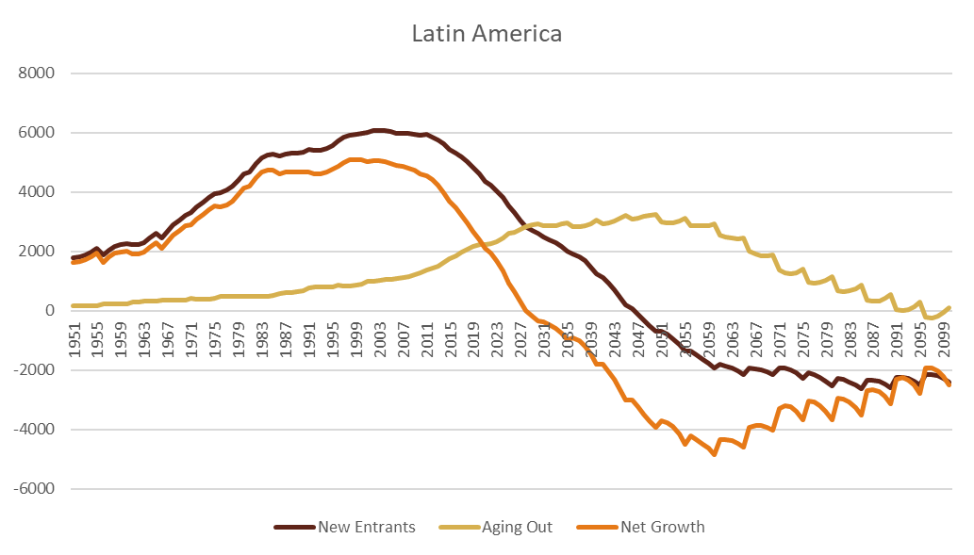
Abundant Labor Markets
Source: UN Population Prospects 2019

Slide 6
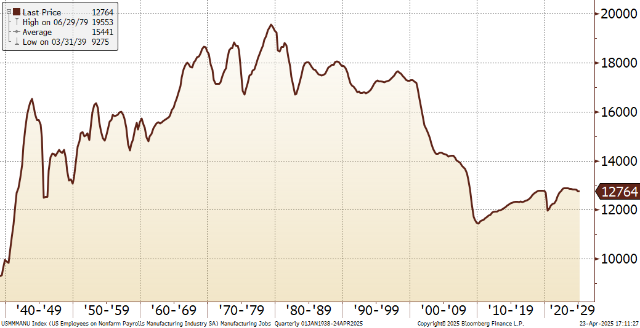
Globalization and Manufacturing Jobs
Source: Bloomberg

Slide 7
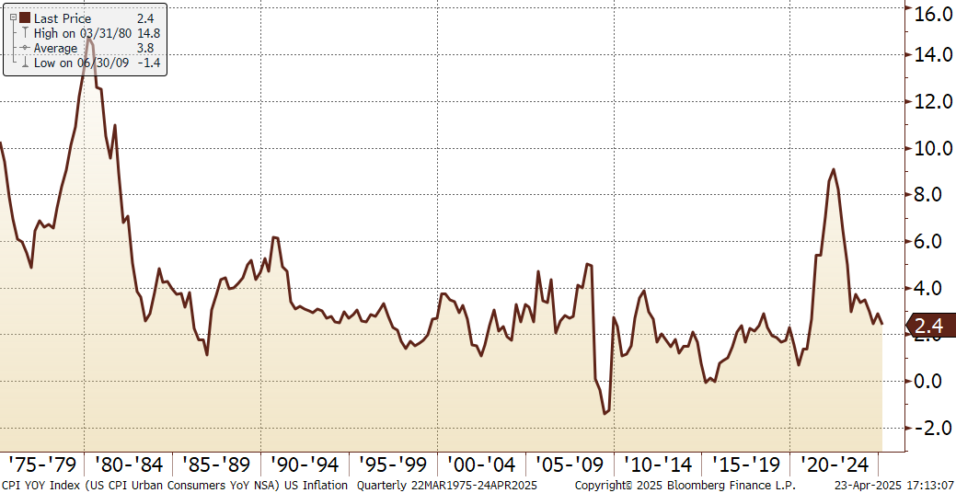
Globalization’s Disinflationary Effect
Source: Bloomberg

Slide 8
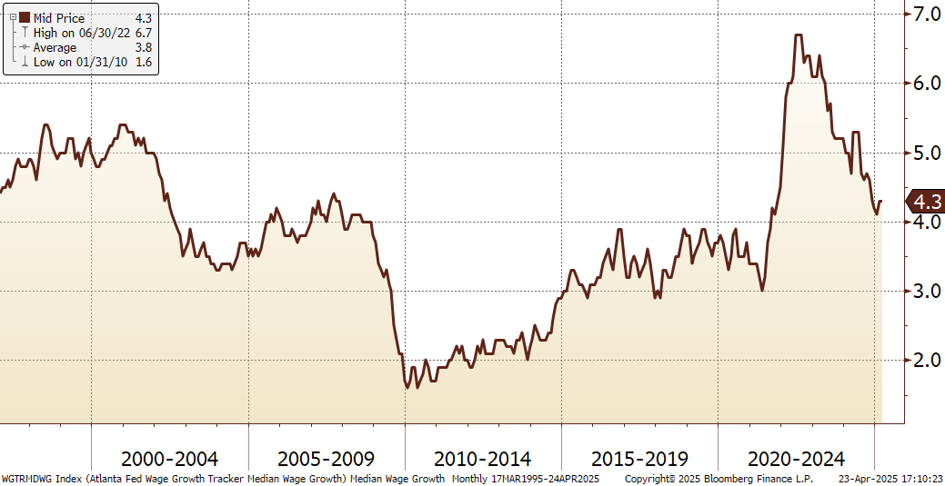
Globalization and Wage Growth
Source: Bloomberg

Slide 9
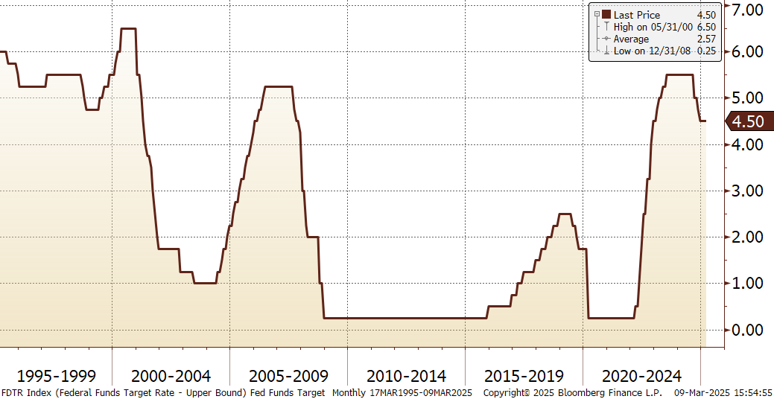
Fed Funds Target Rate
Source: Bloomberg

Slide 10
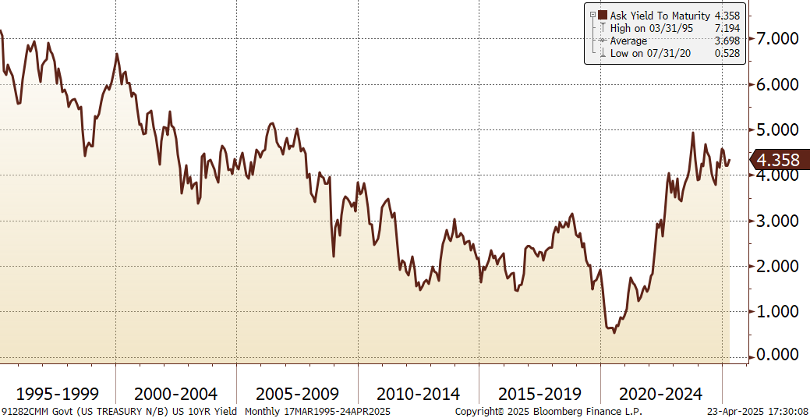
US 10 Year Interest Rates
Source: Bloomberg

Slide 11
Global Fragmentation

Slide 12
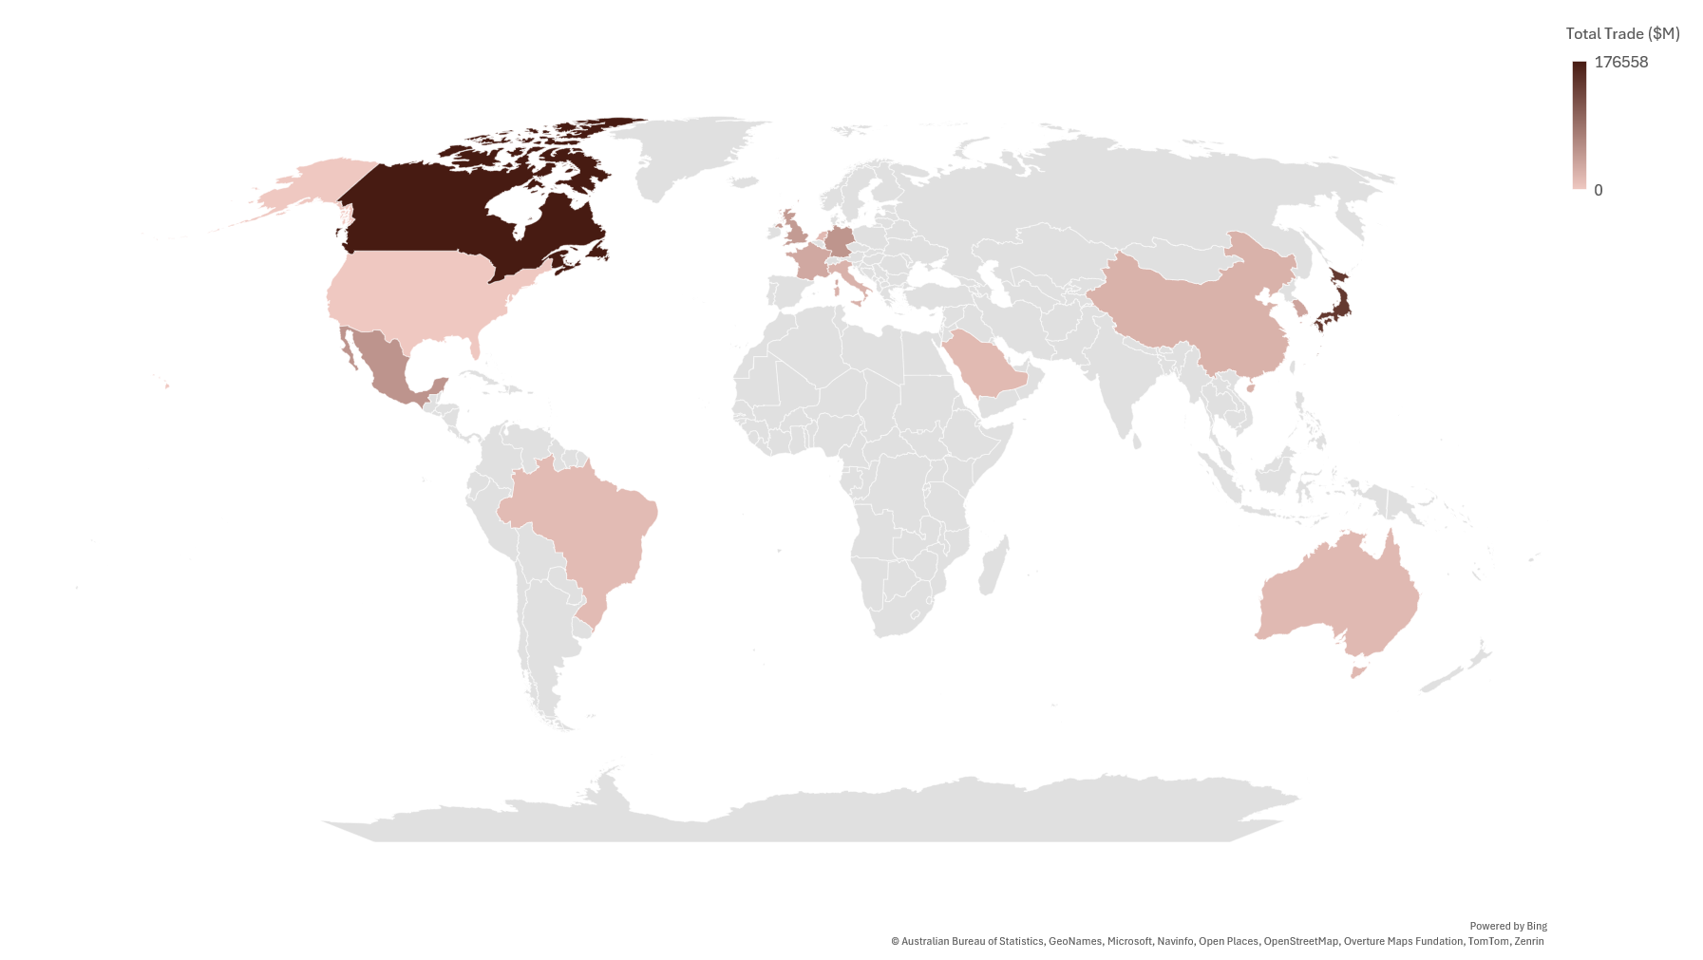
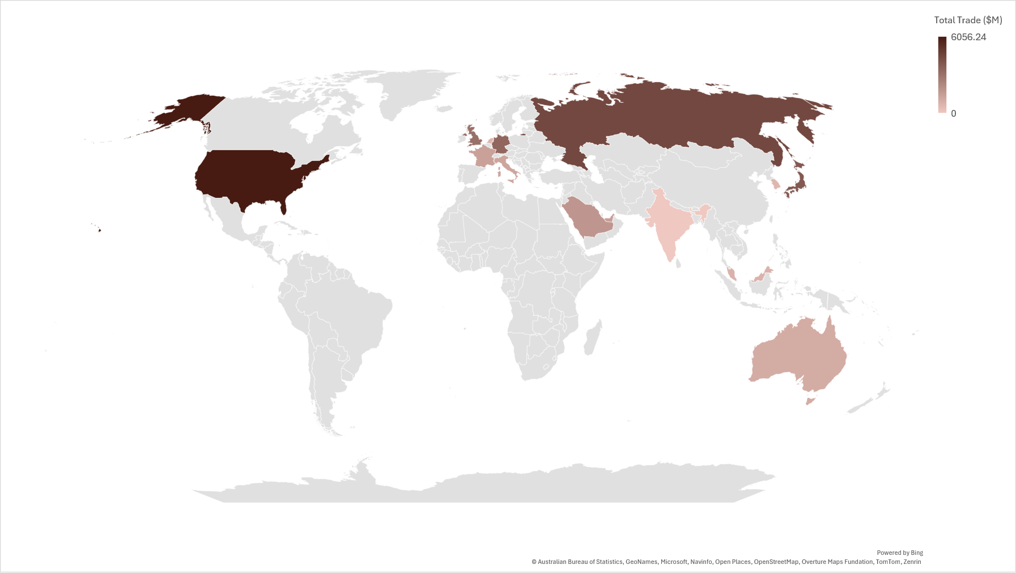
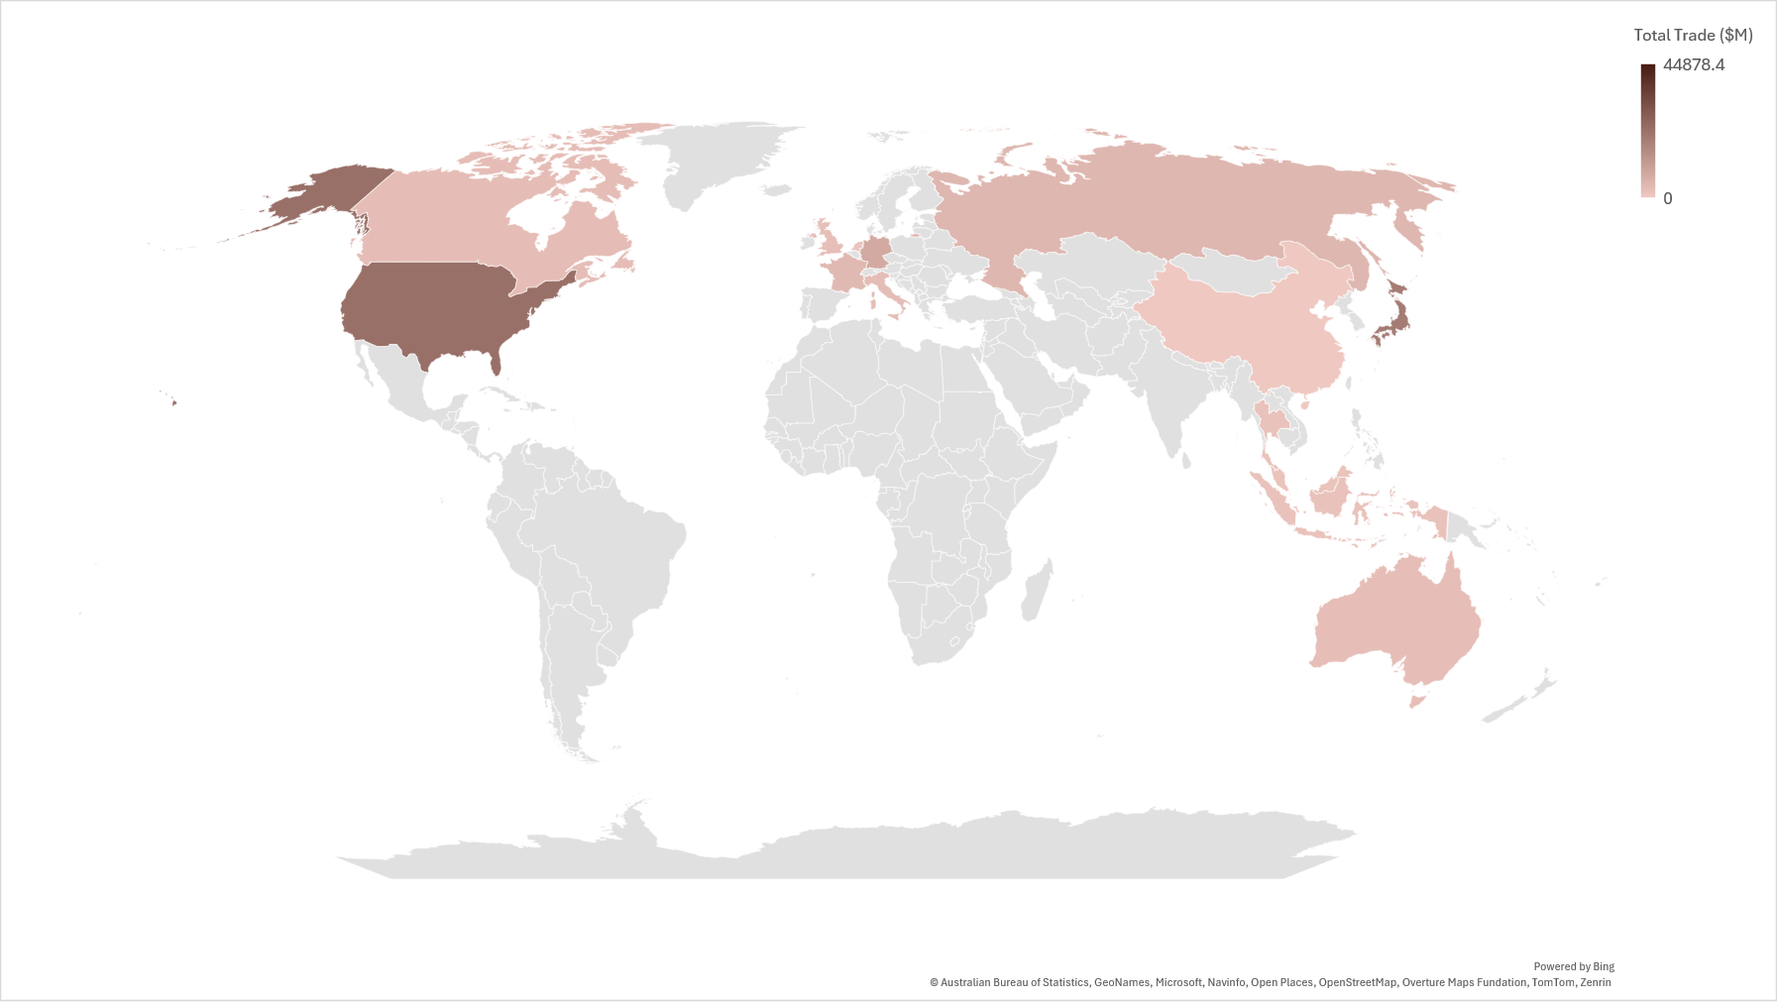
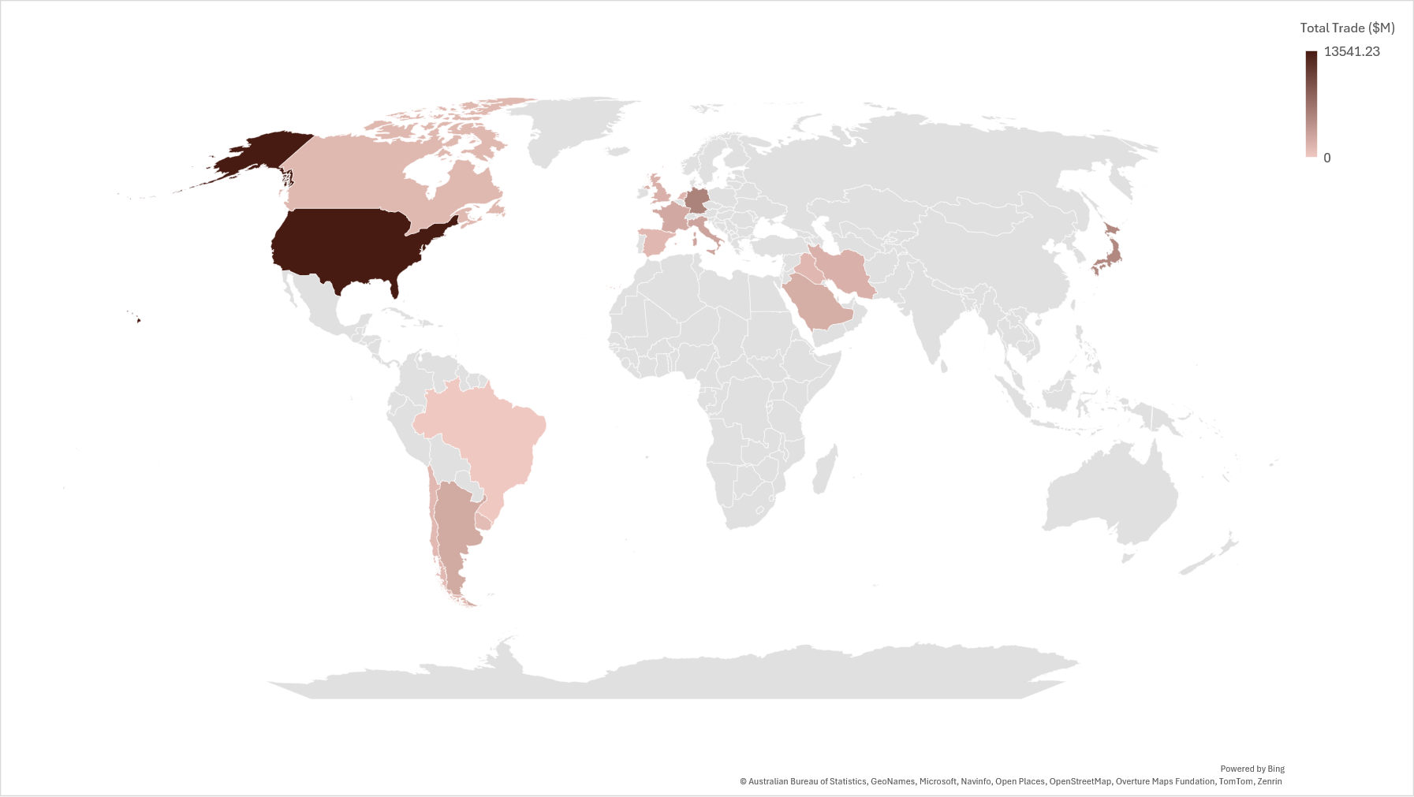
Total Trade - 1990
United States
India
China
Brazil
Source: IMF/World Bank/World Trade Organization

Slide 13
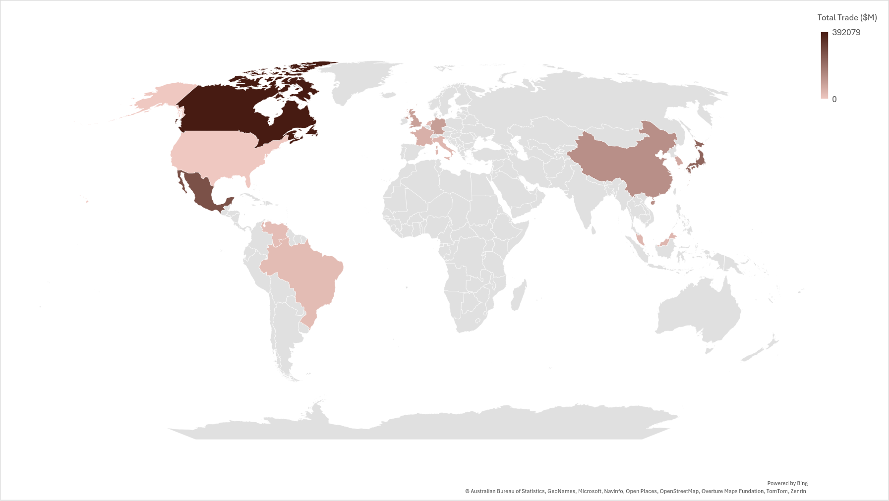
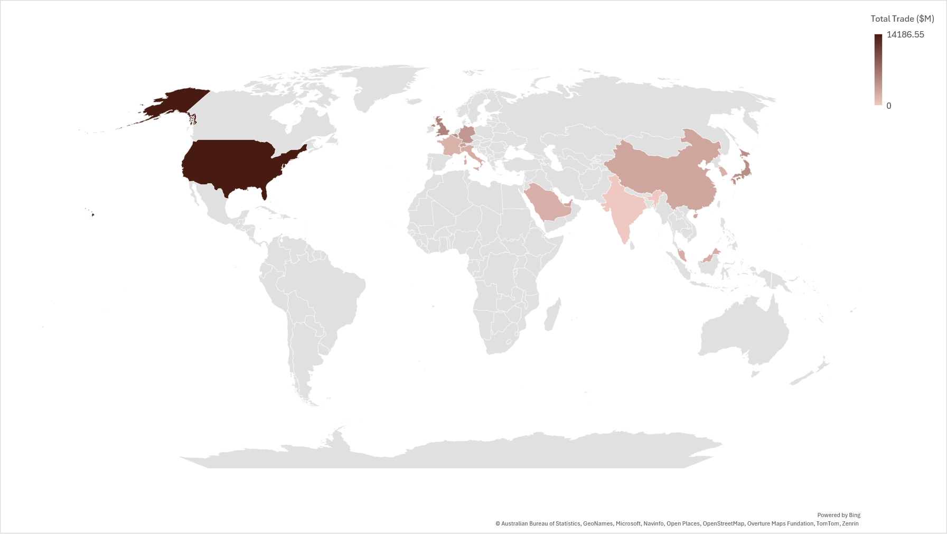
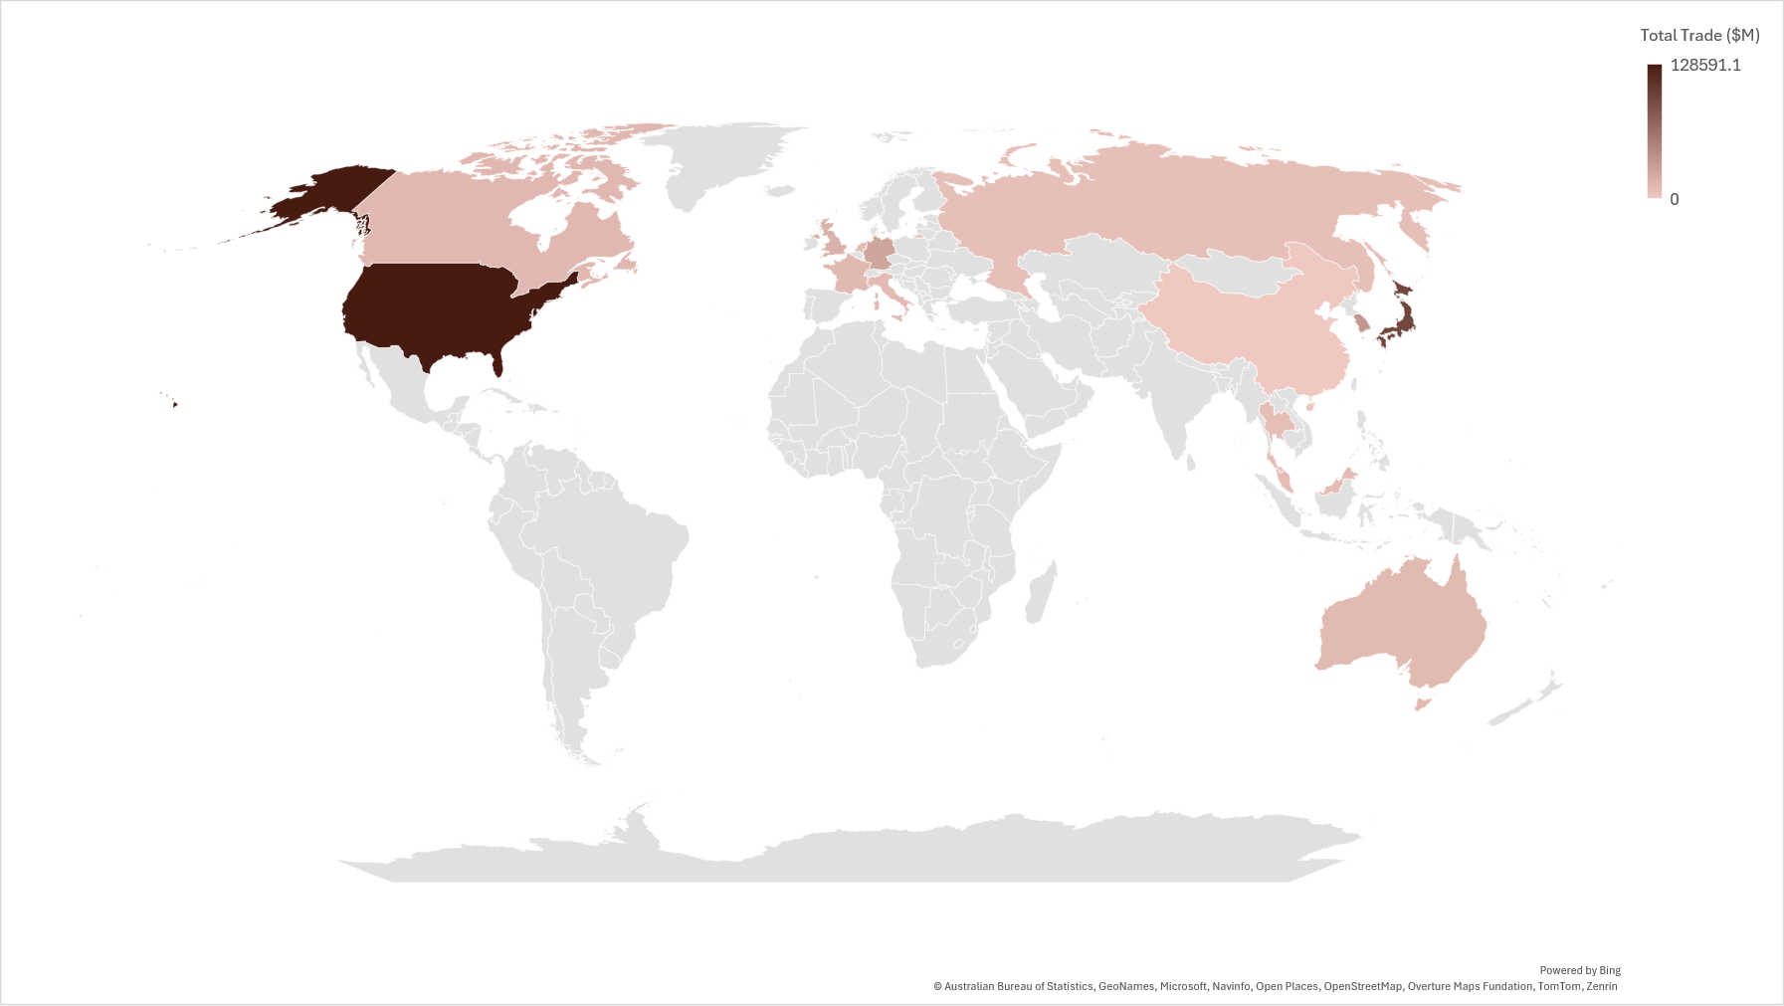
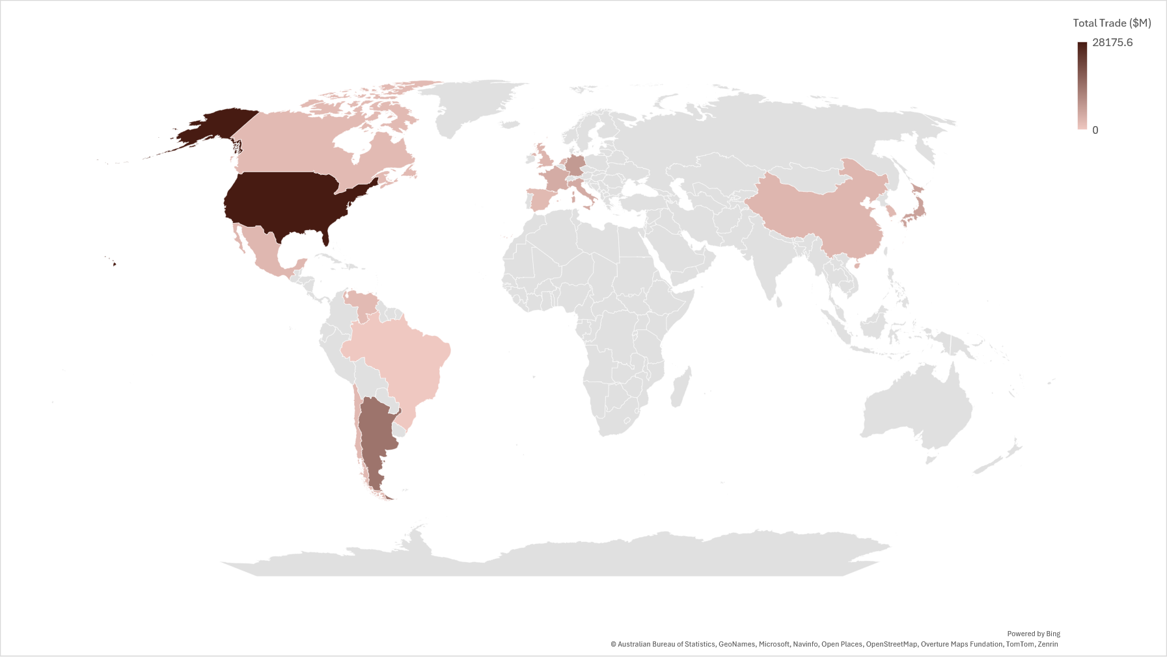
Total Trade - 2000
United States
India
China
Brazil
Source: IMF/World Bank/World Trade Organization

Slide 14
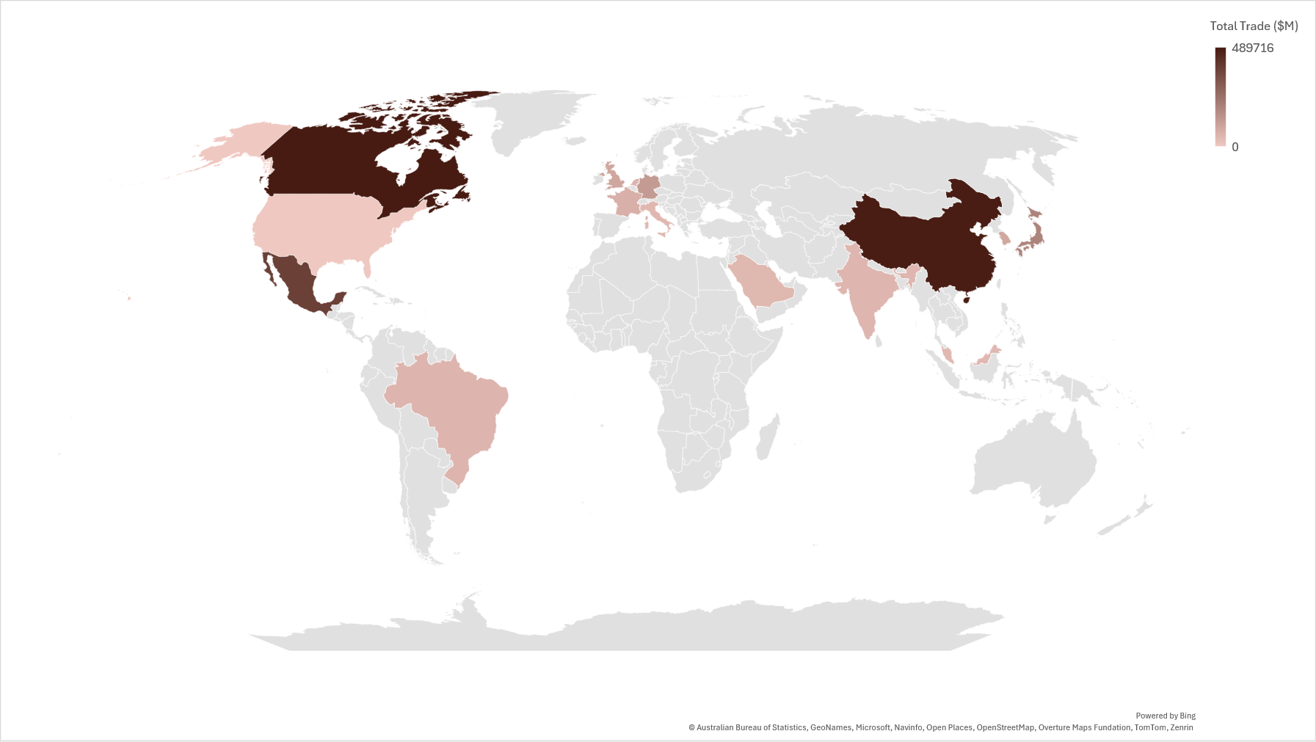
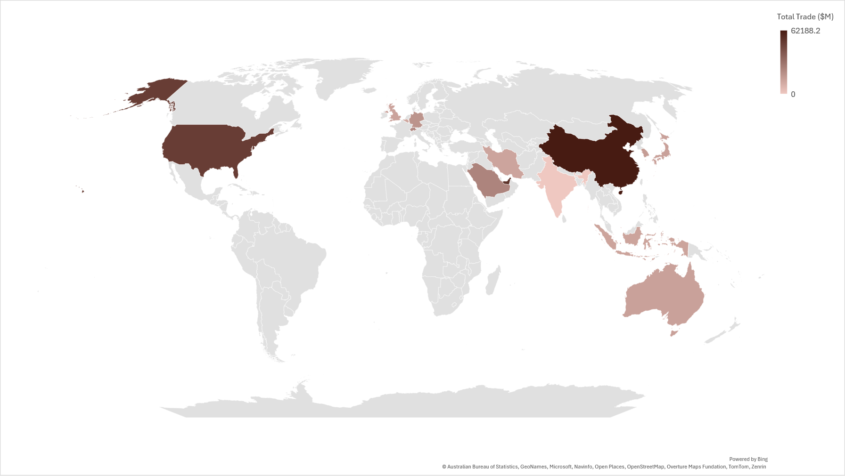
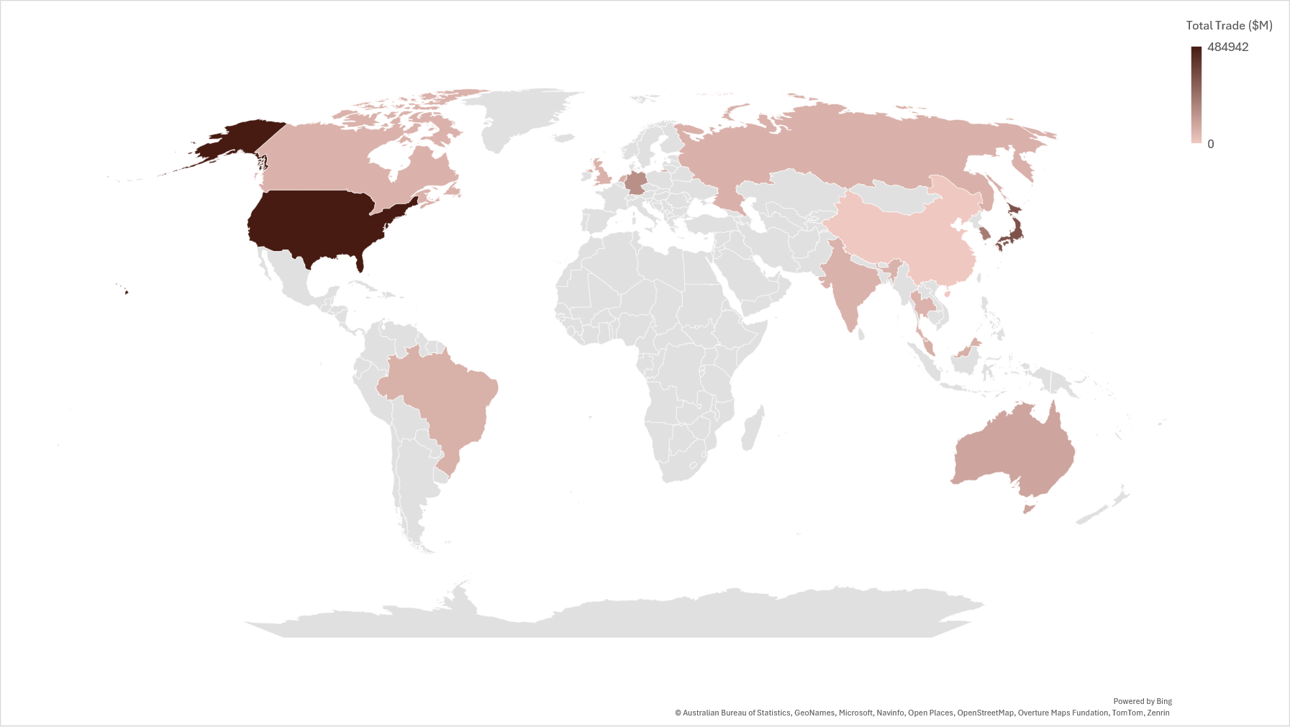
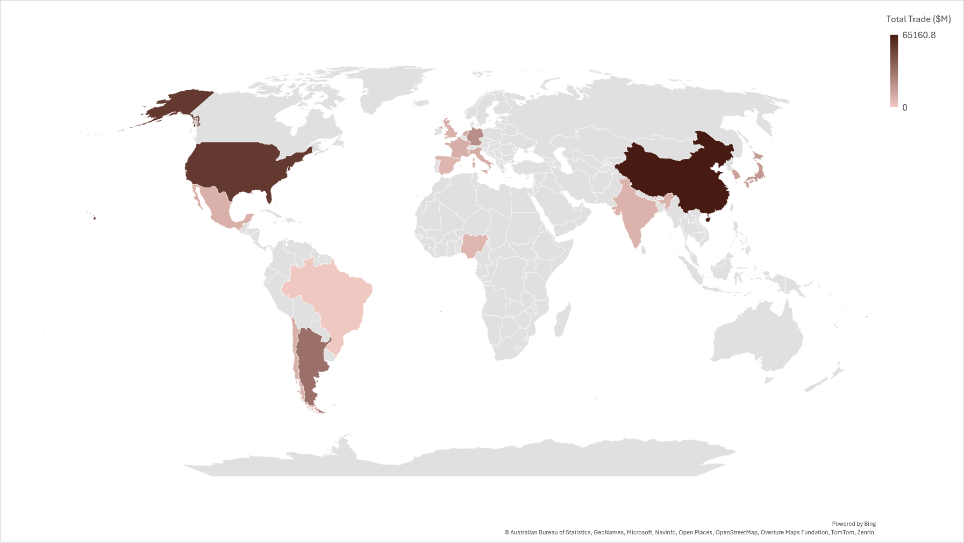
Total Trade - 2010
United States
India
China
Brazil
Source: IMF/World Bank/World Trade Organization

Slide 15
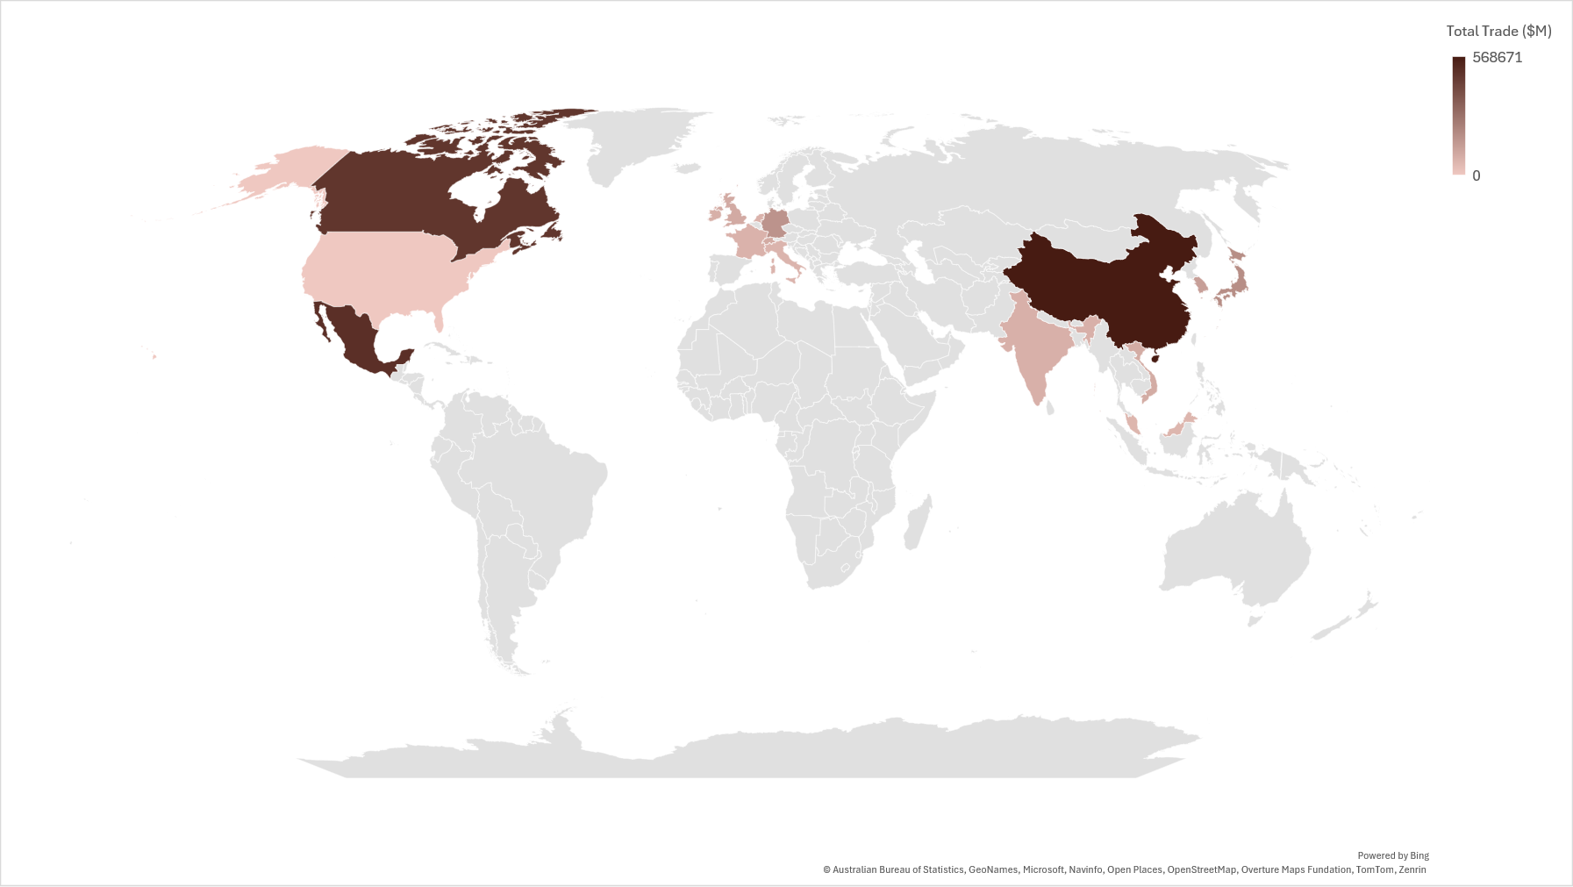
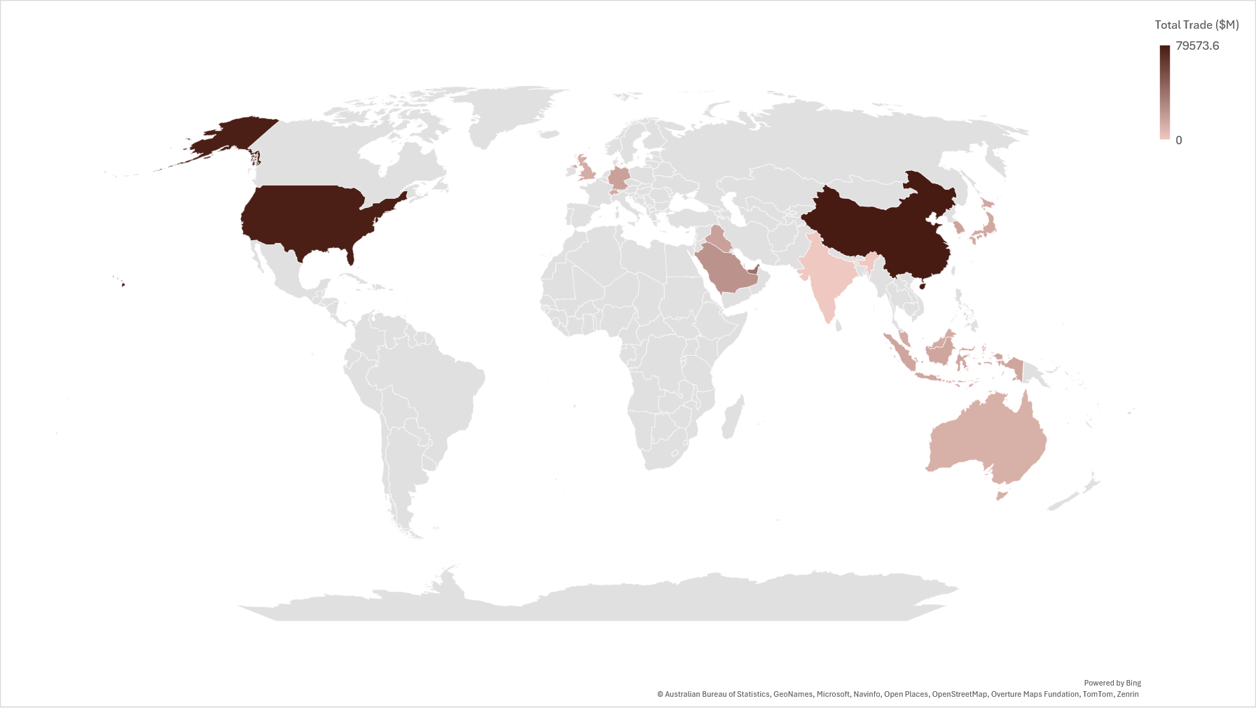
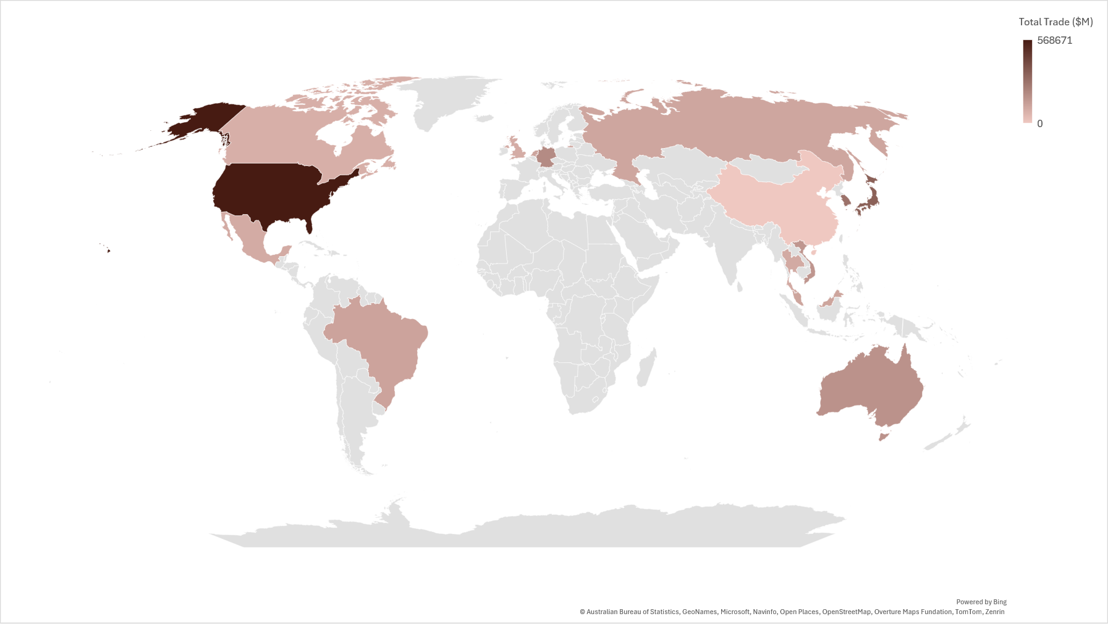
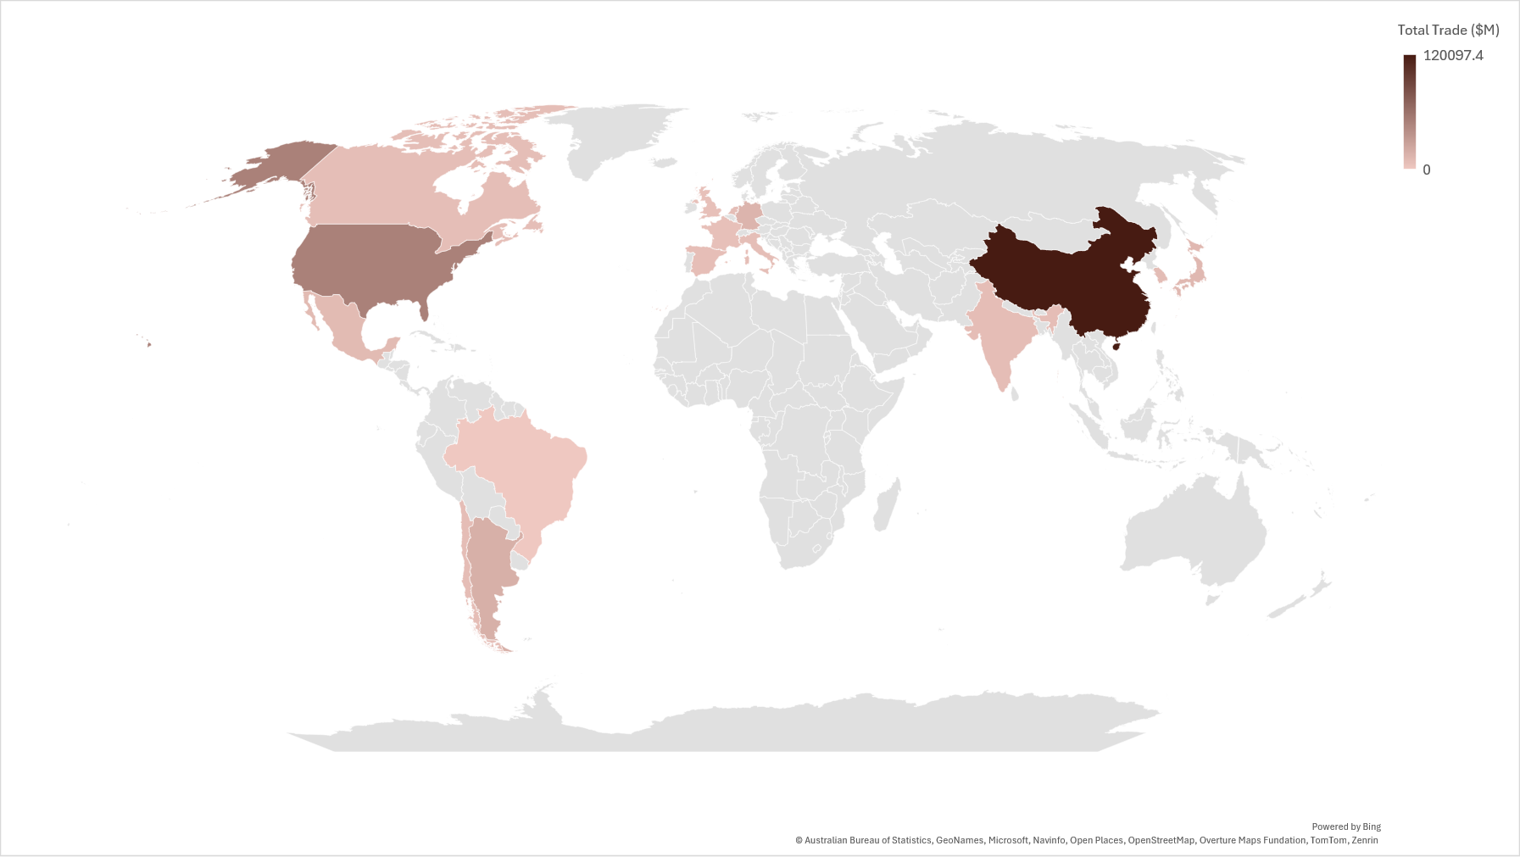
Total Trade – 2020
United States
India
China
Brazil
Source: IMF/World Bank/World Trade Organization

Slide 16
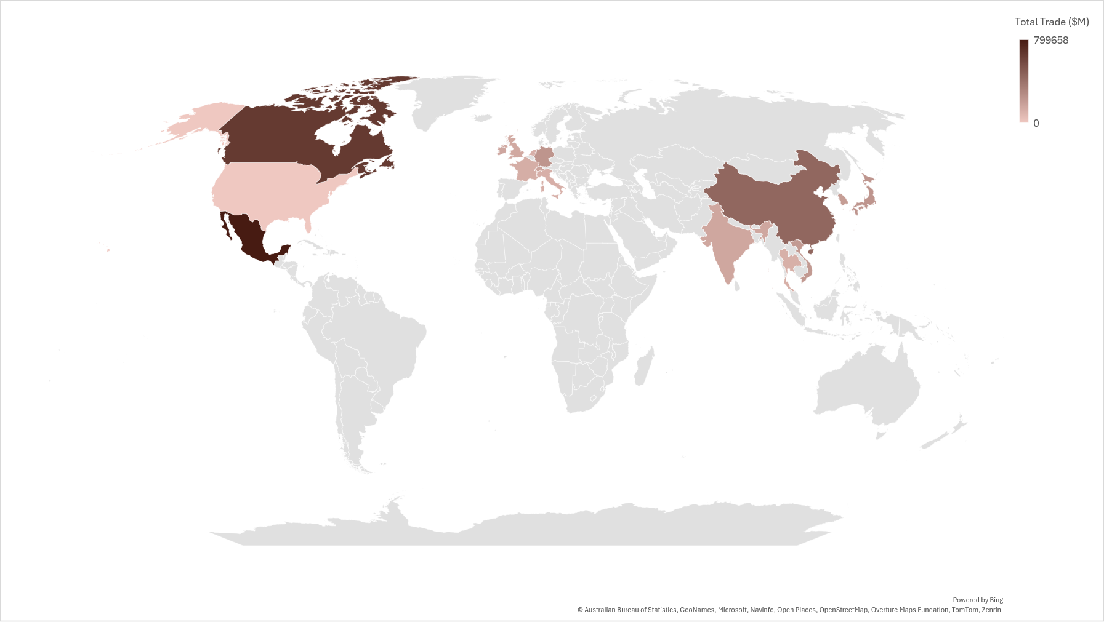
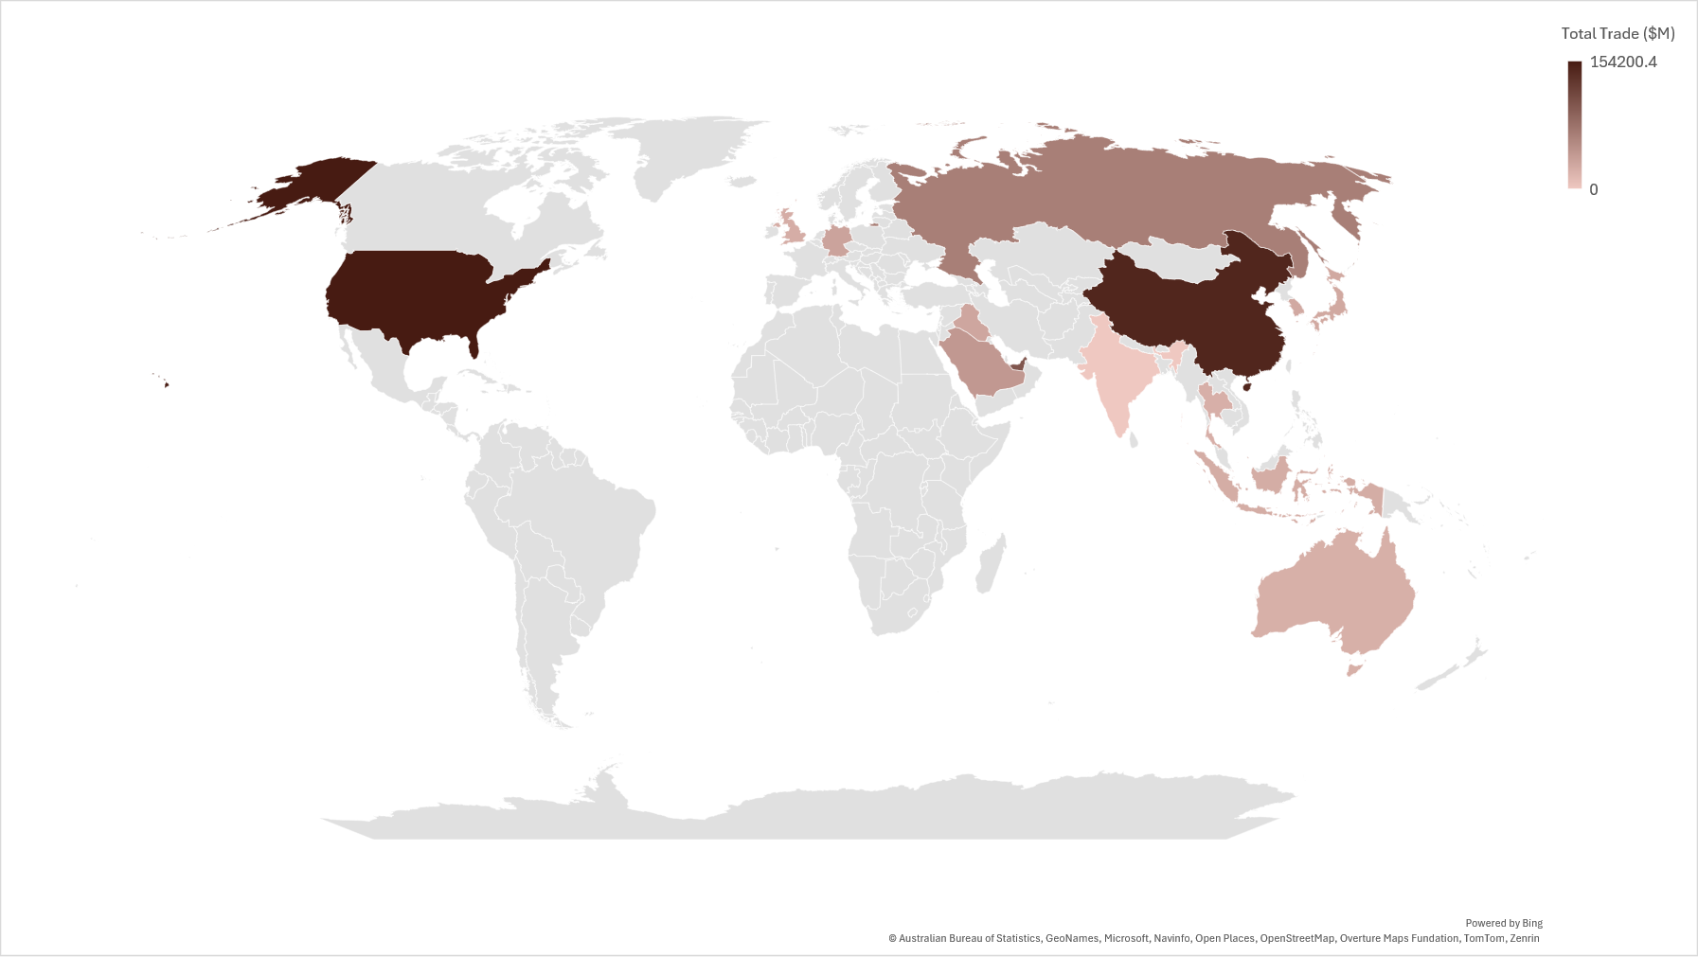
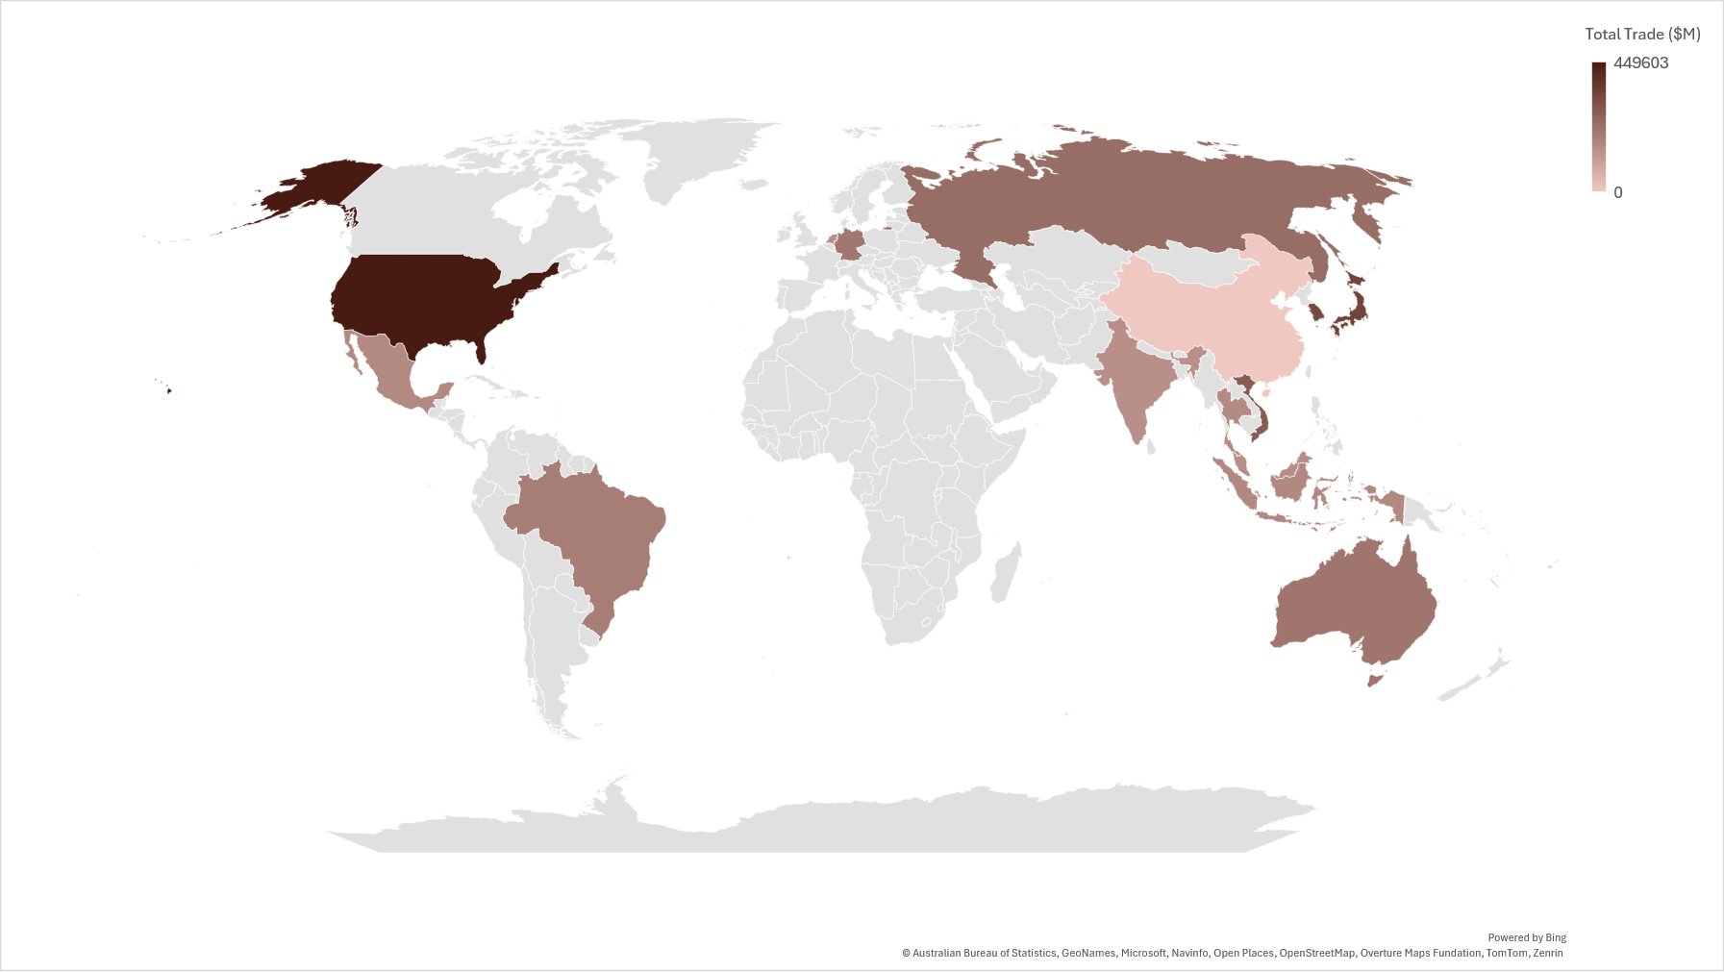
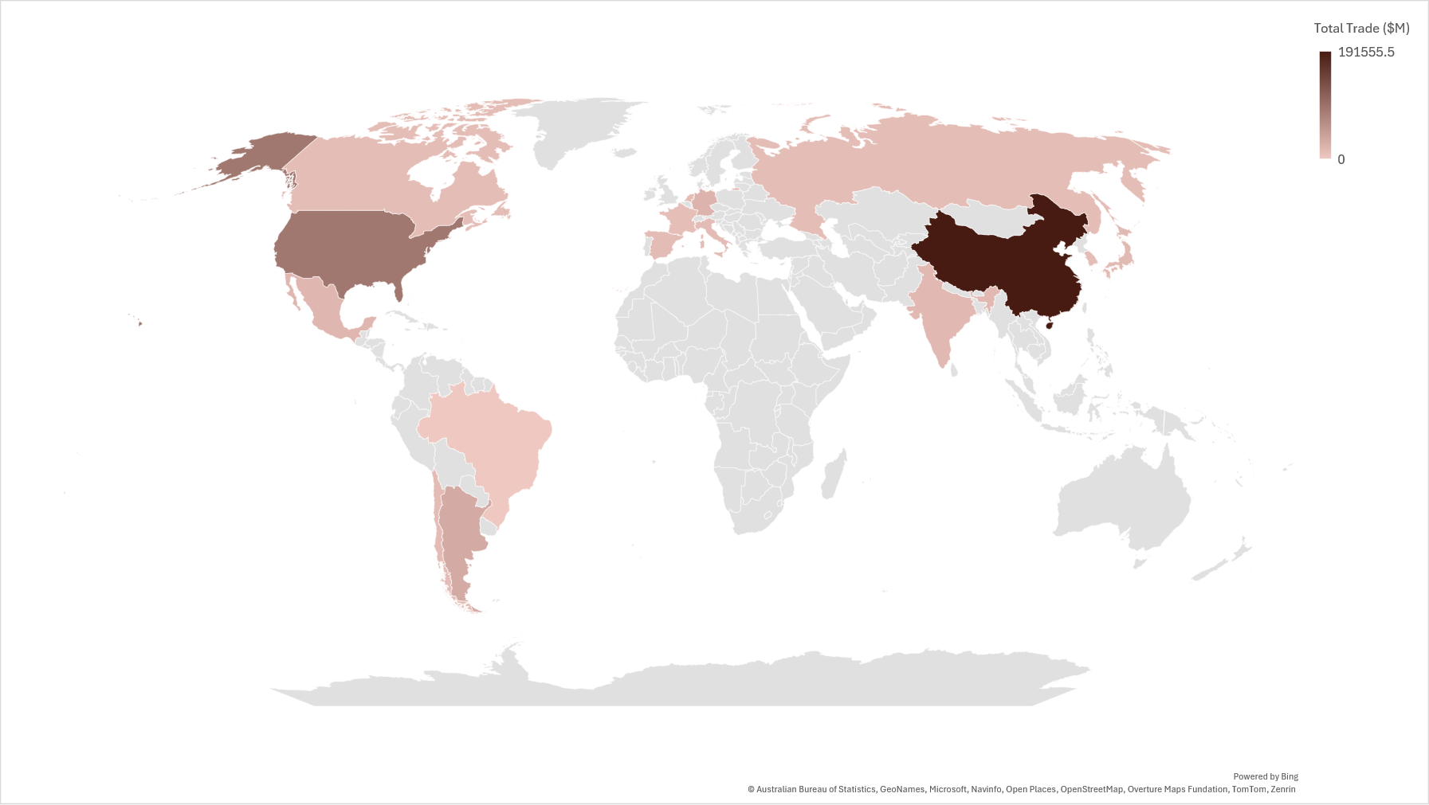
Total Trade – 2025
United States
India
China
Brazil
Source: IMF/World Bank/World Trade Organization

Slide 17
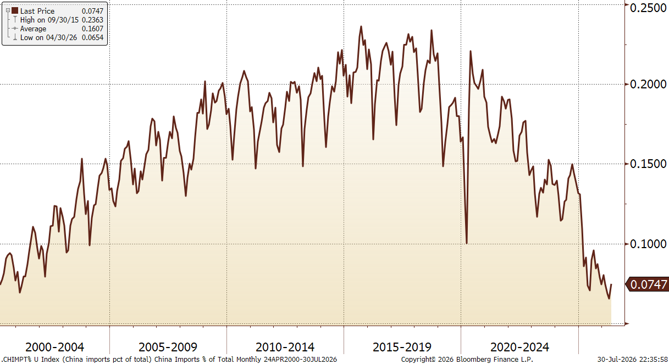
Chinese Imports (% of total U.S. imports)
Source: Bloomberg
Notes:
G 482

Slide 18
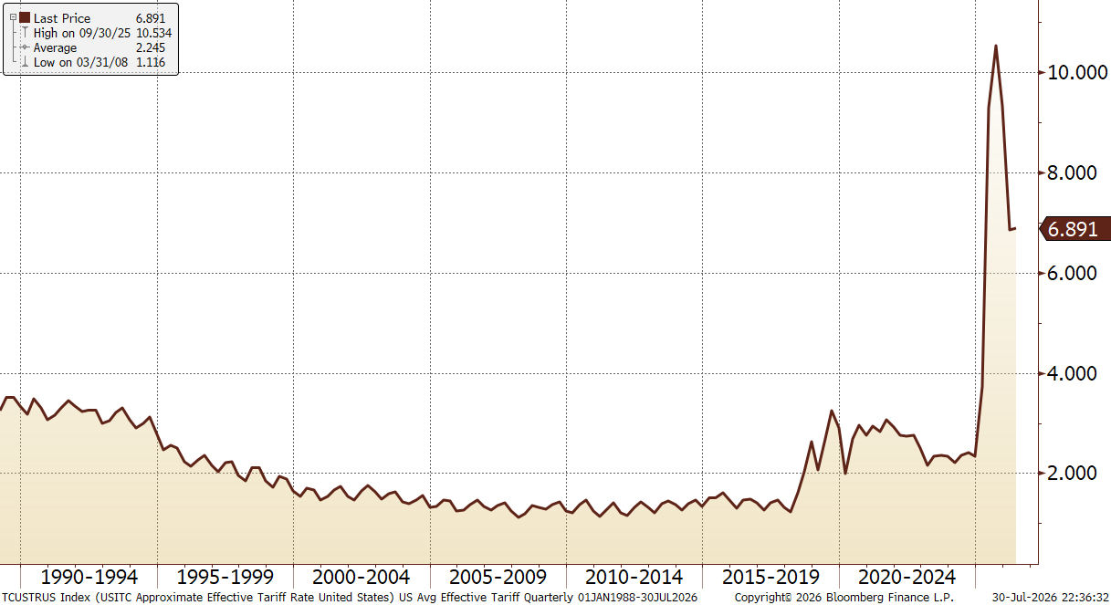
Approximate Effective Tariff Rate
Source: Bloomberg
Notes:
G 462

Slide 19
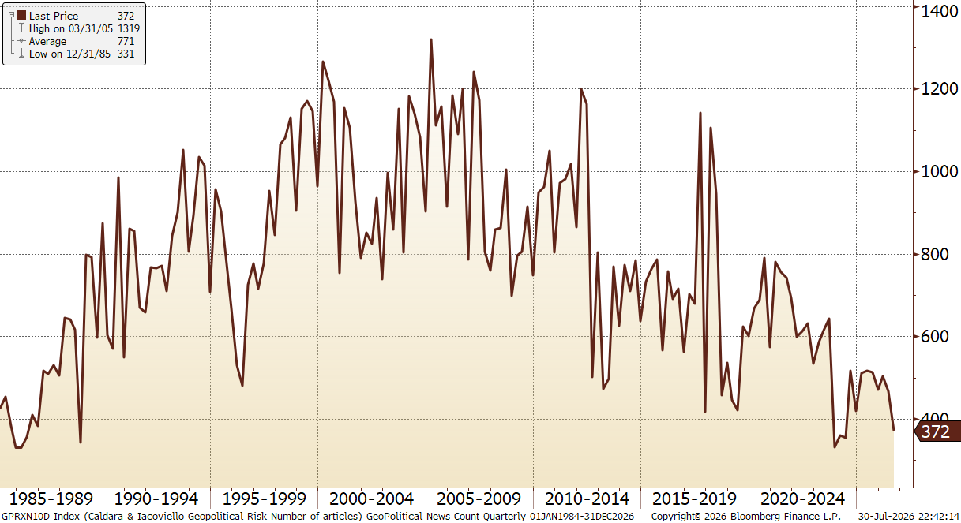
Geopolitical News Article Count
Source: Bloomberg
Notes:
G 496

Slide 20
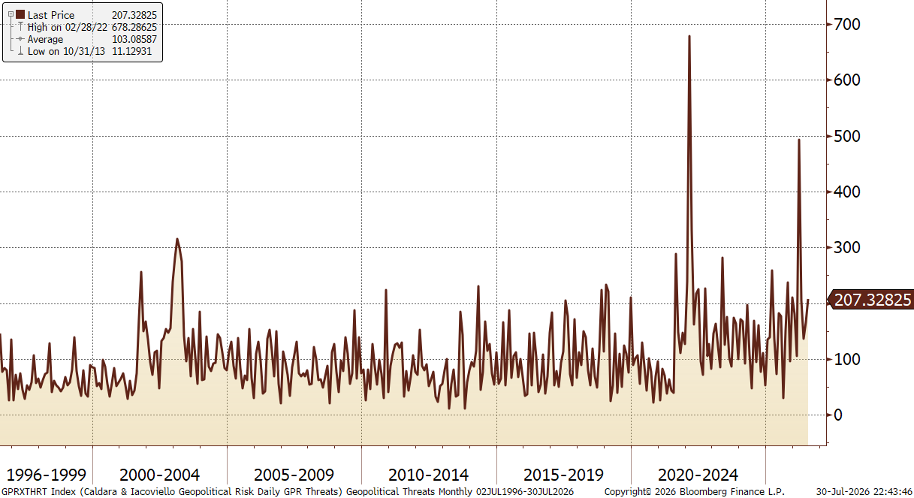
Geopolitical Threats
Source: Bloomberg
Notes:
G 482

Slide 21
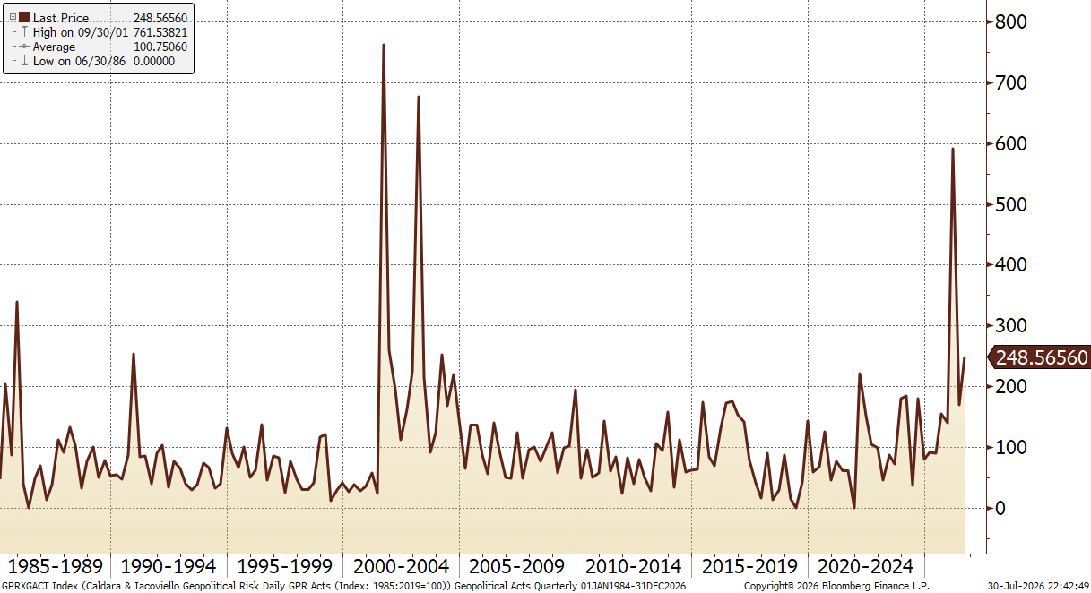
Geopolitical Acts
Source: Bloomberg
Notes:
G 497

Slide 22
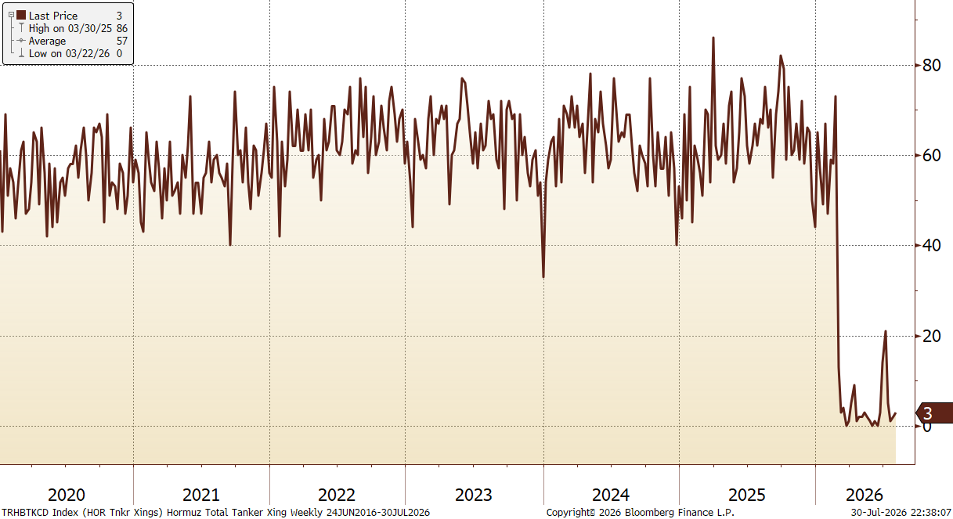
Total Tanker Vessel Crossings – Strait of Hormuz
Source: Bloomberg
Notes:
G 484

Slide 23
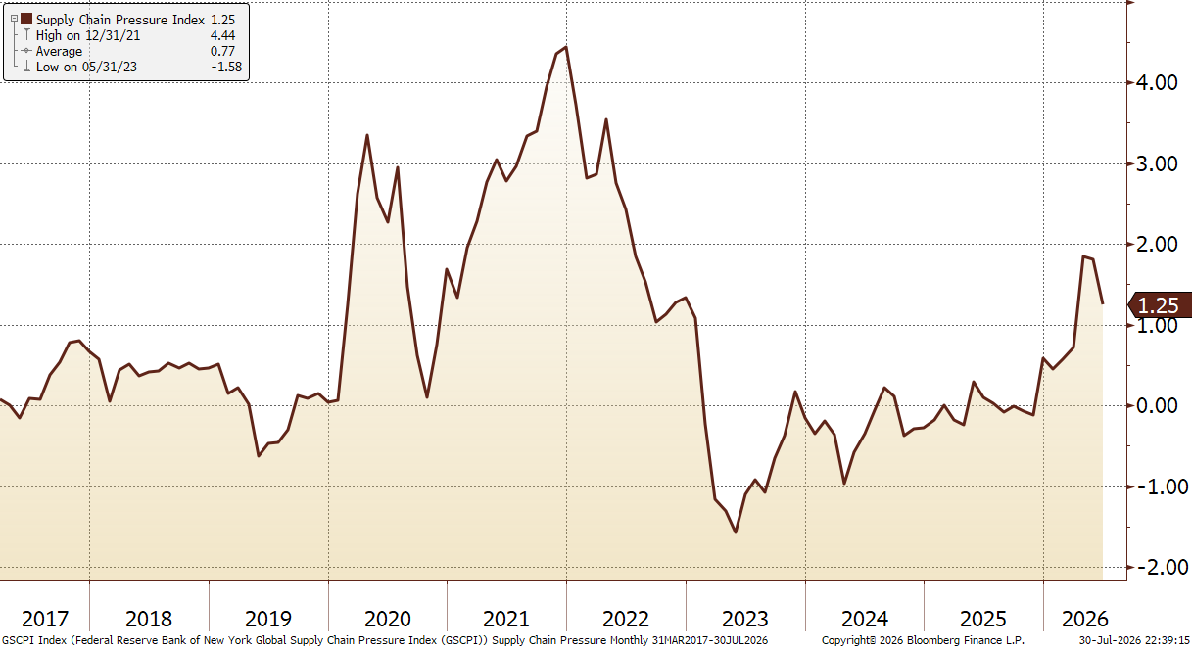
Supply Chain Pressure
Source: Bloomberg
Notes:
G 356

Slide 24
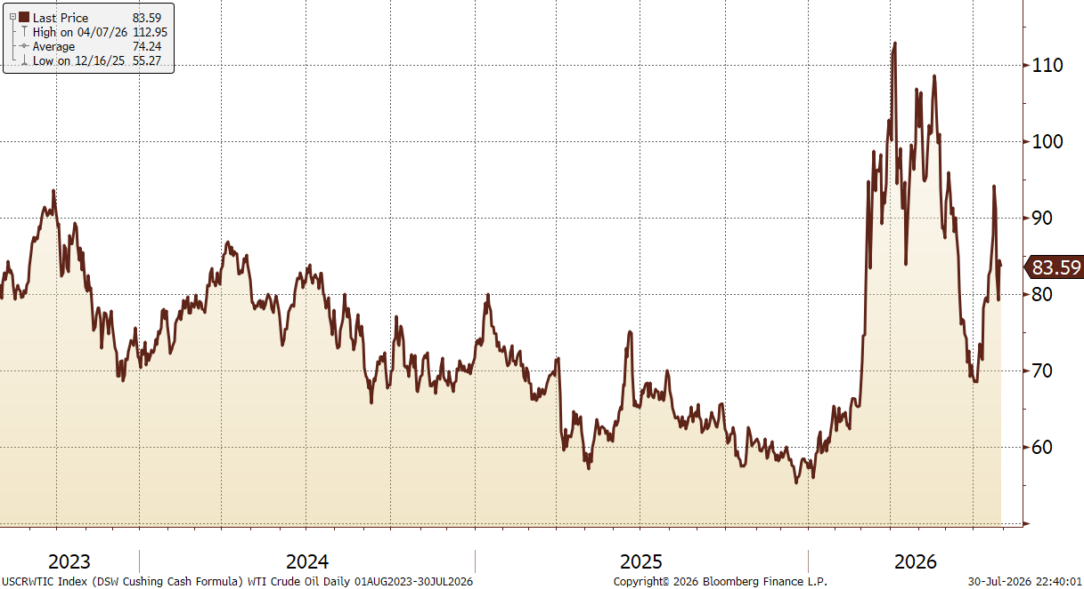
WTI Crude Oil Price
Source: Bloomberg
Notes:
G 199

Slide 25
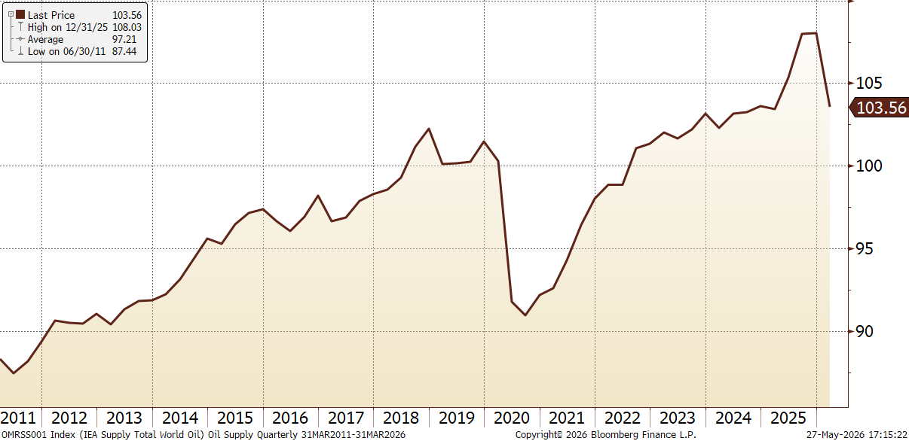
Total World Oil Supply
Source: Bloomberg
Notes:
G 469

Slide 26
The Role of AI

Slide 27
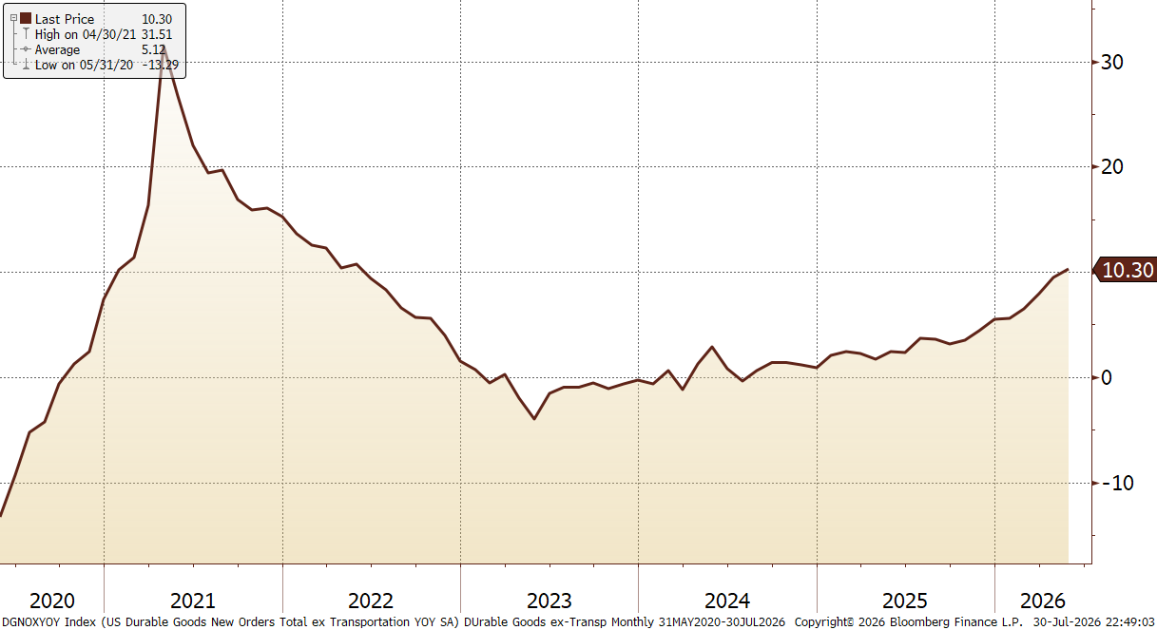
Durable Goods ex-Transportation (yoy, %)
Source: Bloomberg
Notes:
G 501

Slide 28
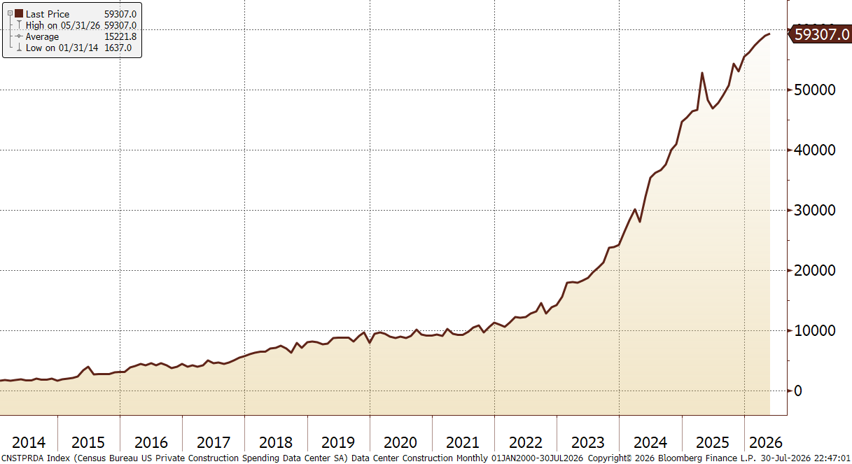
U.S. Spending on Data Center Construction
Source: Bloomberg
Notes:
G 486

Slide 29
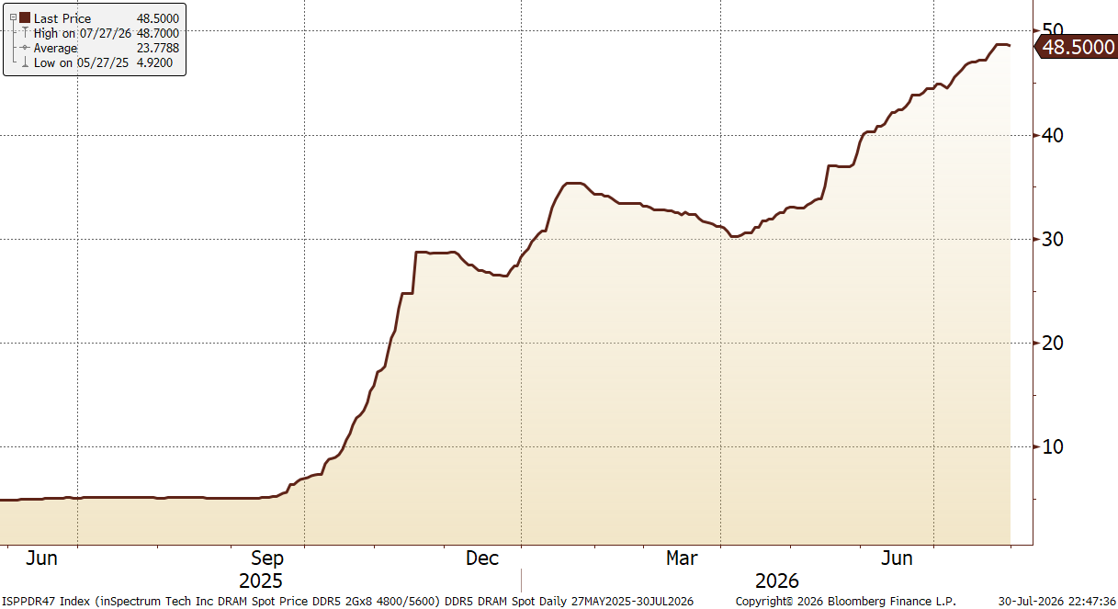
DRAM Spot Prices
Source: Bloomberg
Notes:
G 490

Slide 30
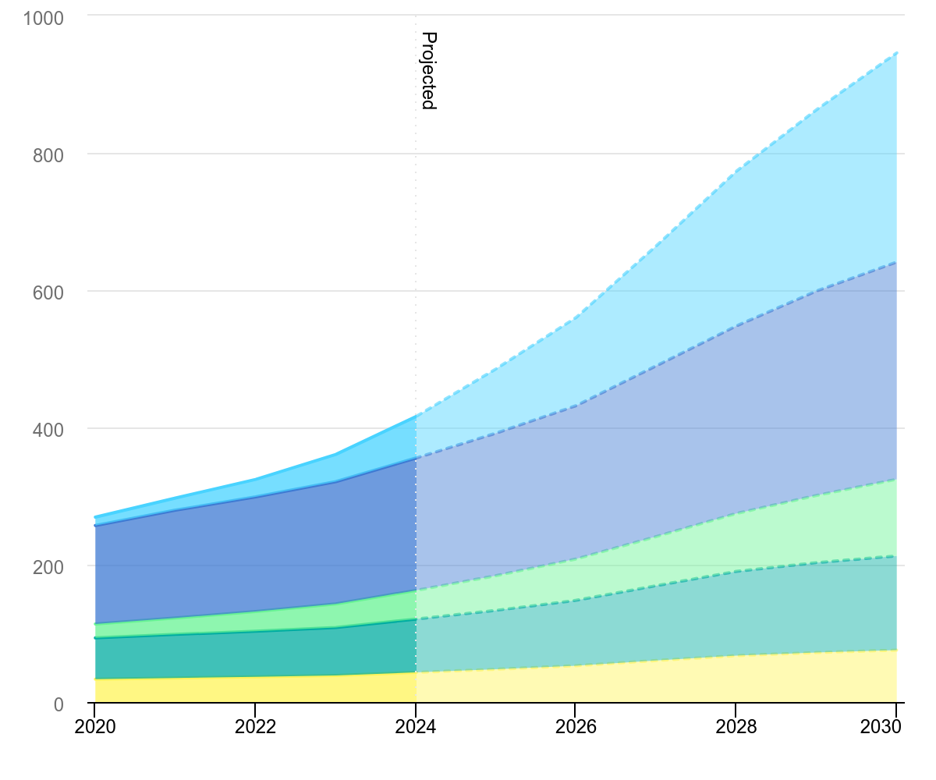
IEA Forecast for Electricity Demand
Source: International Energy Association
IEA (2025), Global data centre electricity consumption, by equipment, Base Case, 2020-2030, IEA, Paris https://www.iea.org/data-and-statistics/charts/global-data-centre-electricity-consumption-by-equipment-base-case-2020-2030, Licence: CC BY 4.0
Notes:
G 489

Slide 31
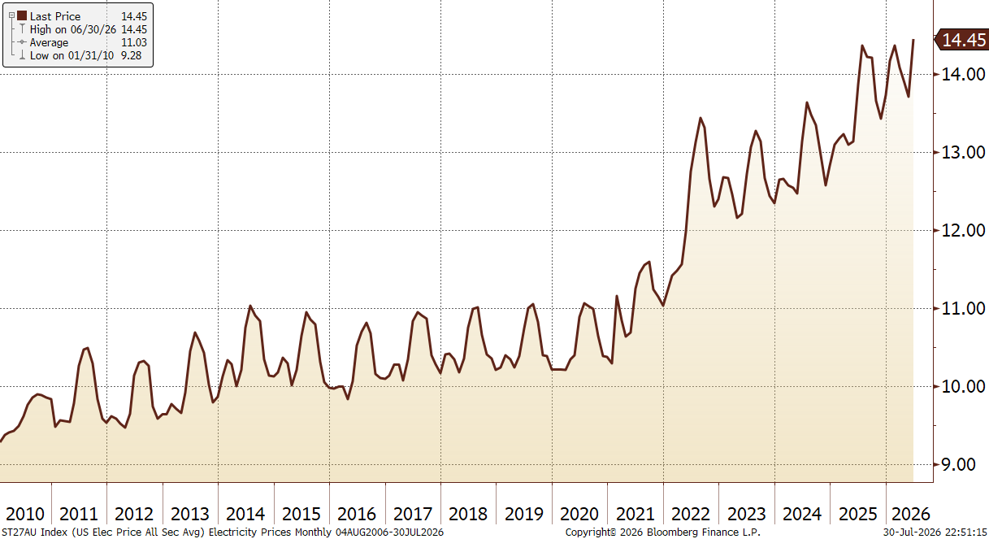
DRAM Spot Prices
Source: Bloomberg
Notes:
G 506

Slide 32
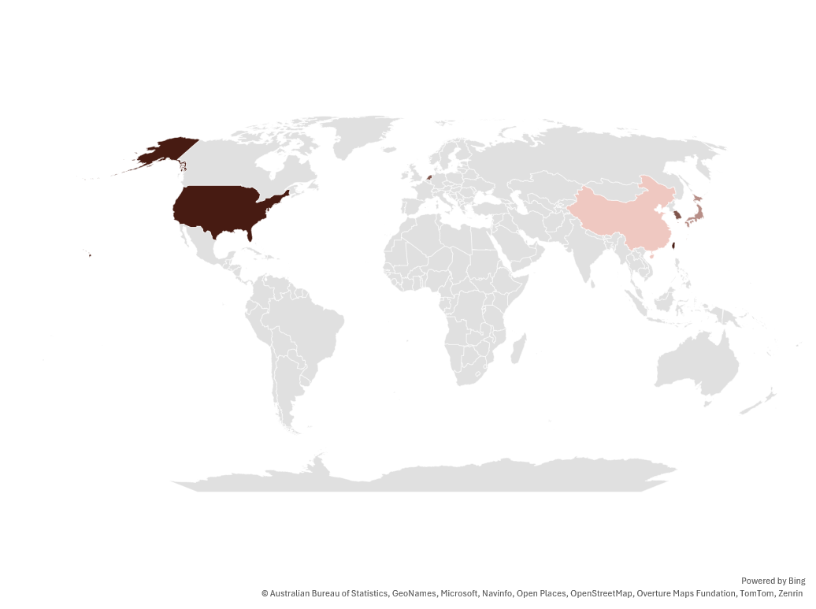
Highly Concentrated Supply Chain
Source: Gartner Group
Notes:
G 506

Slide 33
Productivity Rebound
Source: Bloomberg

Slide 34
Demographic and Debt Dynamics

Slide 35
Population Growth is Slowing
Source: UN World Population Growth Prospects 2022
Notes:
In 1804, the world hit 1 billion people. In 1927, 123 years later, the world hit 2 billion people. In 1960, the world hit 3 billion people. In 1999, 39 years later, the world doubled to 6 billion people. The global population is not expected to double again.

Slide 36
Fertility Plummeting
Source: UN World Population Growth Prospects 2022

Slide 37
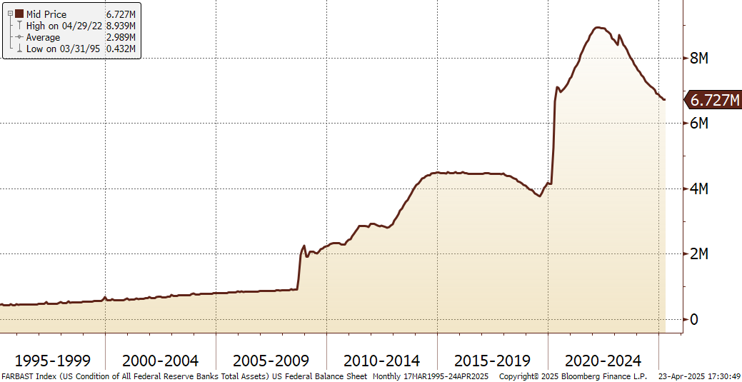
Federal Reserve Bank Balance Sheet
Source: Bloomberg

Slide 38
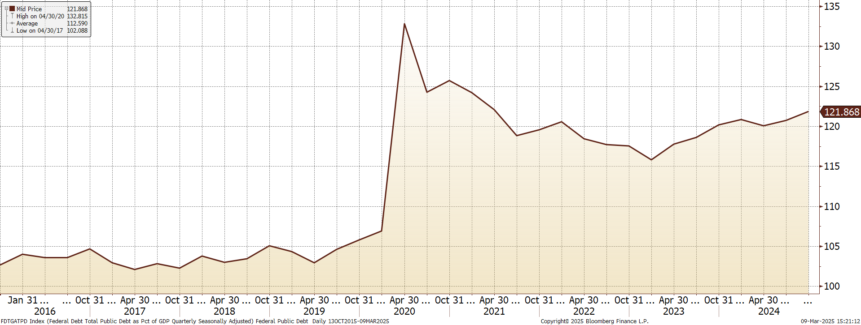
Federal Debt as a % GDP
Source: Bloomberg

Slide 39
A Local Perspective

Slide 40
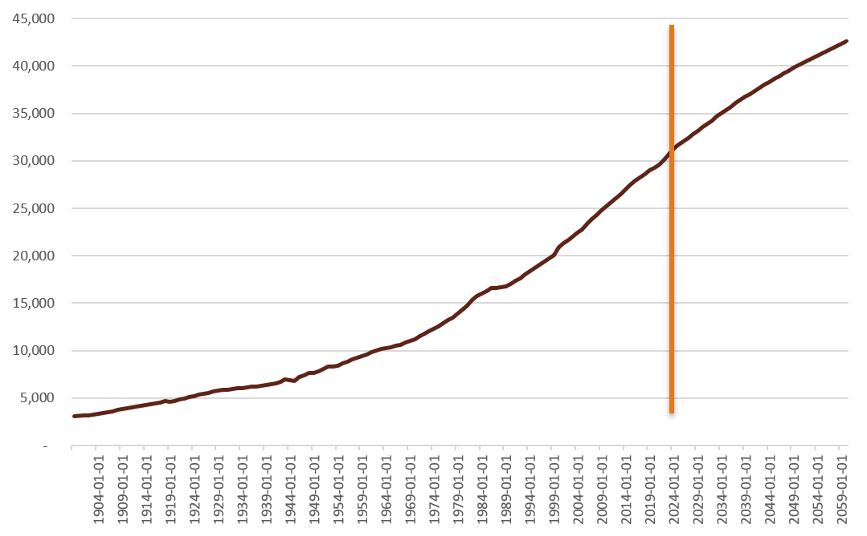
Texas Population Forecast
Source: U.S. Census Bureau via FRED® and Texas Demographic Center
Notes:
In 1804, the world hit 1 billion people. In 1927, 123 years later, the world hit 2 billion people. In 1960, the world hit 3 billion people. In 1999, 39 years later, the world doubled to 6 billion people. The global population is not expected to double again.

Slide 41
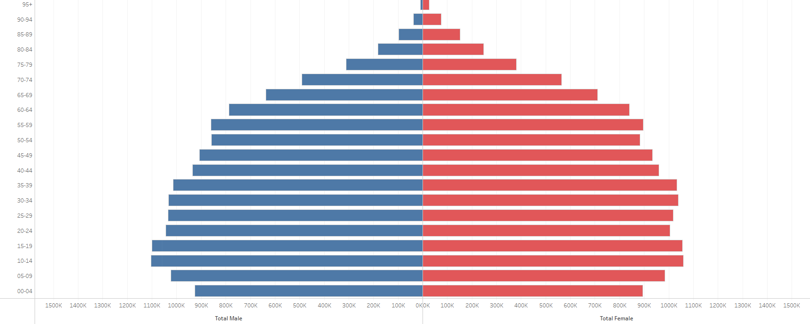
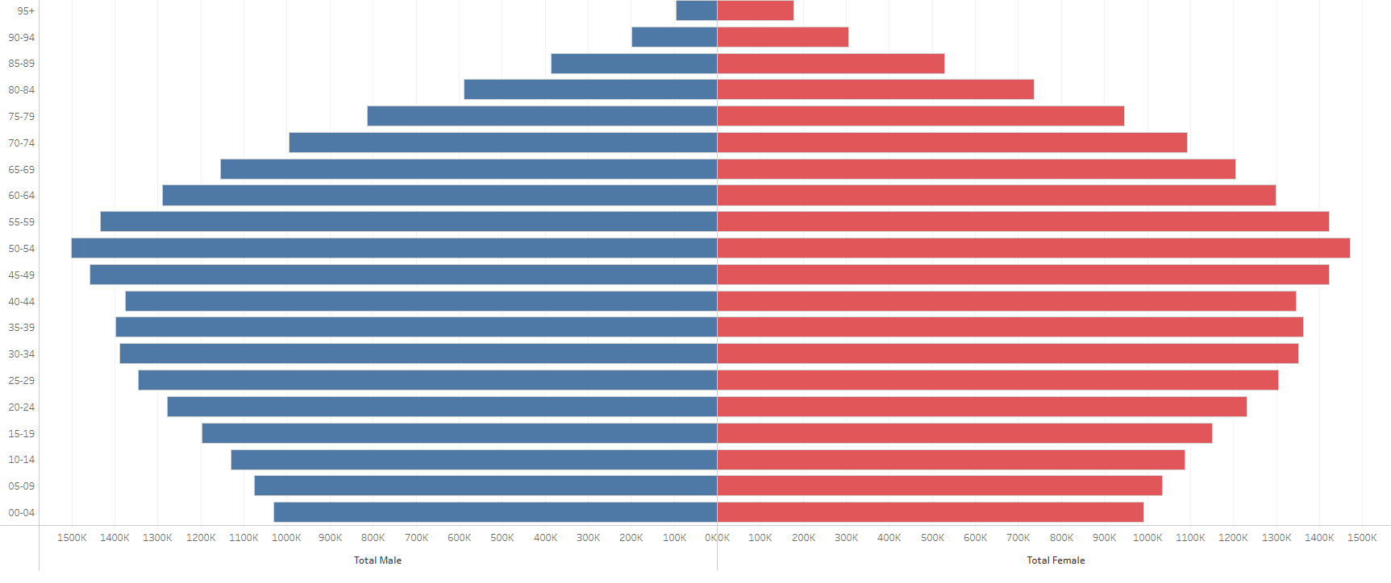
Texas Population Pyramid
2025
2060 Projection
Source: Texas Demographic Center

Slide 42
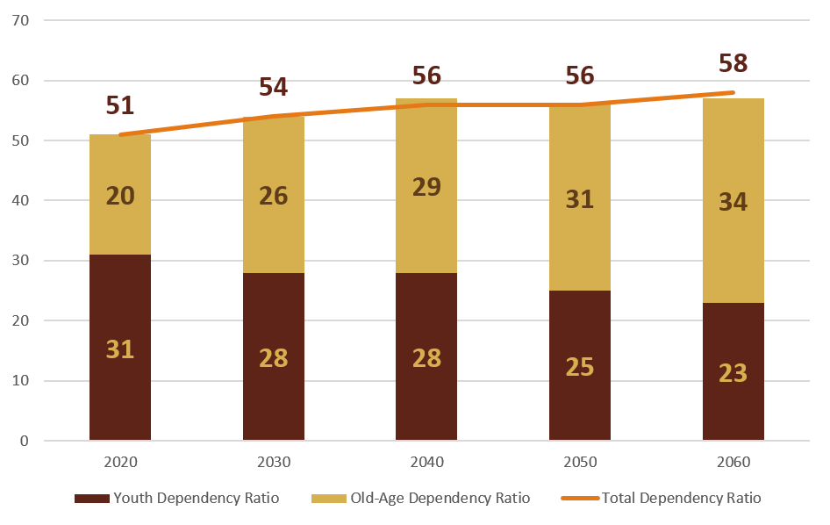
Texas Dependency Ratio
Source: Texas Demographic Center

Slide 43

2023 TEXPERS Asset Allocation
Source: Maples Group/TEXPERS Composite

Slide 44

2023 TEXPERS Alternatives Allocation
Source: Maples Group/TEXPERS Composite

Slide 45

2025 Investment Return Assumptions
Source: Texas Public Retirement Board, December 2025 Report

