Slide 1


AI
Chatbots
for Pension Systems
Joe Gimenez

Slide 2
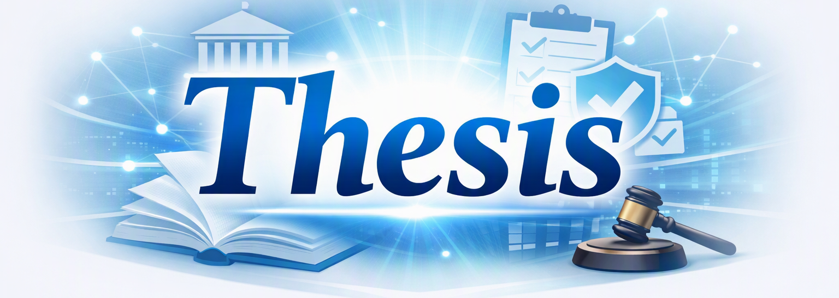
AI Chatbots can transform pension systems by:
  Improving member service
  Reducing administrative load
  Strengthening relationships with Members/Legislators/Public
  Serving as current and historic guide for Trustee oversight
Notes:
AI Chatbots are more than service tools — they are catalysts for transforming pension fund operations. By connecting data, people, and processes, they help overcome the historic challenge of information silos and enable smarter, faster, and more transparent decision‑making.
🧩 Visual Composition
Central Hub: A glowing circle labeled “AI‑Driven Integration” with a network icon or interlocking nodes. Beneath it: “Breaking down silos across departments, data, and time.”
Surrounding Elements (four segments):
🔗 Unified Knowledge – Connects member, trustee, and administrative data.
🧠 Informed Decisions – Provides real‑time insights for governance and operations.
⚙️ Operational Continuity – Preserves institutional memory and improves workflow.
🌐 Collaborative Transparency – Strengthens trust among members, staff, and legislators.
Color Palette: Continue your blue‑gray‑orange theme with subtle gradients and your G3 Public Relations logo in the lower‑right corner for brand consistency.
🏛️ Tone and Purpose
This slide should feel visionary — not technical. It invites trustees and administrators to see AI as a governance ally, not just a helpdesk tool. It’s the bridge between modernization and institutional wisdom.

Slide 3
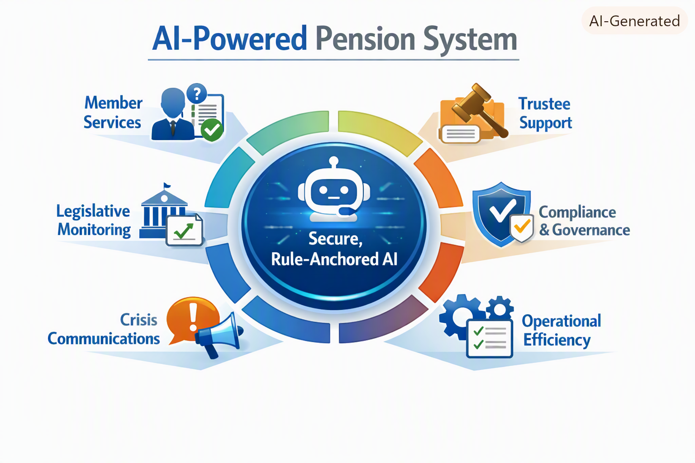

Slide 4
  They are able to break down information silos within pension systems as connected, intelligent, and integrated tools that simplify the incredible complexity of pension fund work.
How Will ChatBots Do This?
Notes:
Let’s start with the basics. What is a ChatBot? A chatbot is an AI‑powered digital assistant that interacts with users through text or voice to answer questions, guide processes, and automate routine tasks — all while maintaining consistency, accuracy, and availability 24/7.

Slide 5
  A ChatBot is an AI-powered assistant that is programmed to interact with users to answer questions, guide processes and automate routine tasks.
What is a ChatBot?
Notes:
Let’s start with the basics. What is a ChatBot? A chatbot is an AI‑powered digital assistant that interacts with users through text or voice to answer questions, guide processes, and automate routine tasks — all while maintaining consistency, accuracy, and availability 24/7.

Slide 6
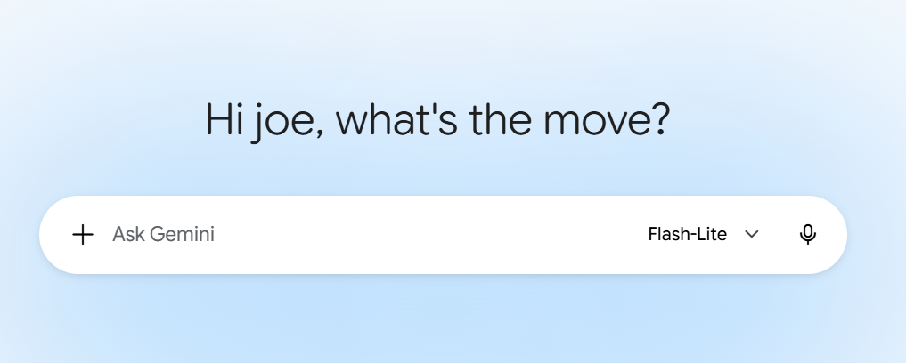
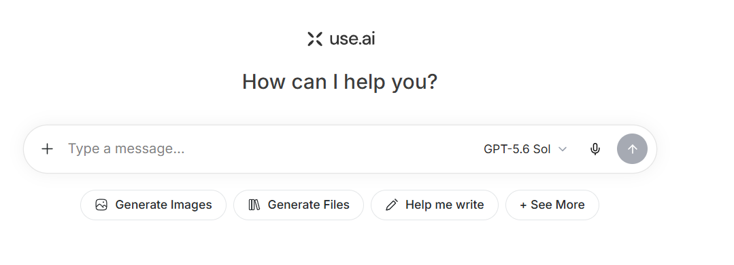
Google Gemini
ChatBot Examples
Chat GPT
Notes:
Let’s start with the basics. What is a ChatBot? A chatbot is an AI‑powered digital assistant that interacts with users through text or voice to answer questions, guide processes, and automate routine tasks — all while maintaining consistency, accuracy, and availability 24/7.

Slide 7
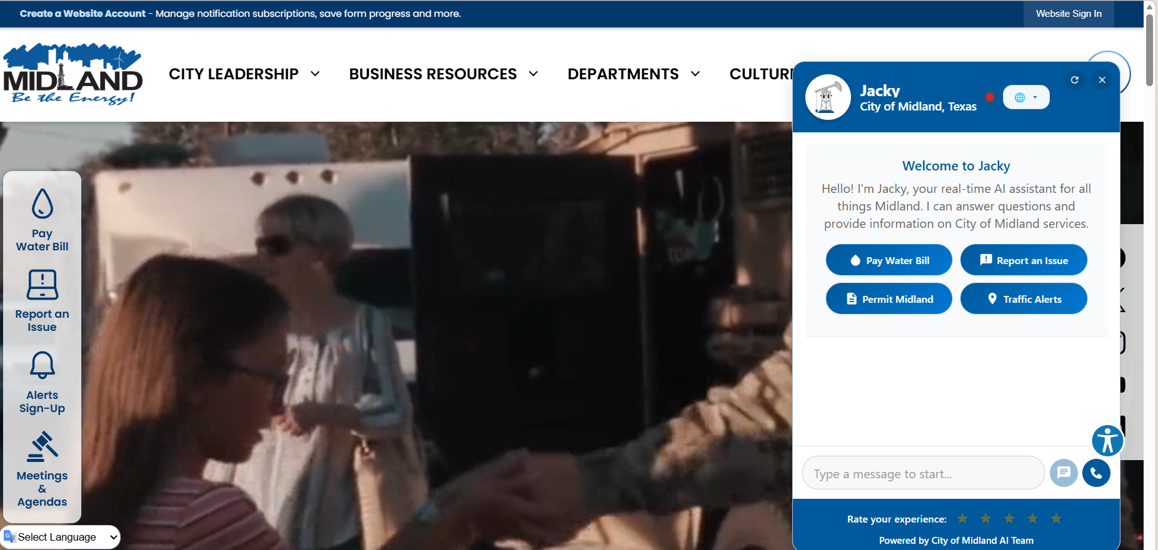
ChatBot Examples
Notes:
Let’s start with the basics. What is a ChatBot? A chatbot is an AI‑powered digital assistant that interacts with users through text or voice to answer questions, guide processes, and automate routine tasks — all while maintaining consistency, accuracy, and availability 24/7.

Slide 8
What Could AI ChatBots Do for Pension Systems?
Notes:
We should not just think of ChatBots as a customer service tool. It can be so much more in terms of assisting trustees with their management of the pension system. Properly fed the right information, they can act as a historic brain for the organization, regarding investments, compliance, communications, etc. I’d like you to think of chatbots as being much more useful than a website because, if they are properly built and maintained over time, they can serve as the institutional brain of an organization.
AI‑Powered Assistant — interacts intelligently with users
Answers Questions — provides instant help and information
Automates Tasks — handles routine inquiries 24/7
Human Escalation — routes complex issues to staff

Slide 9
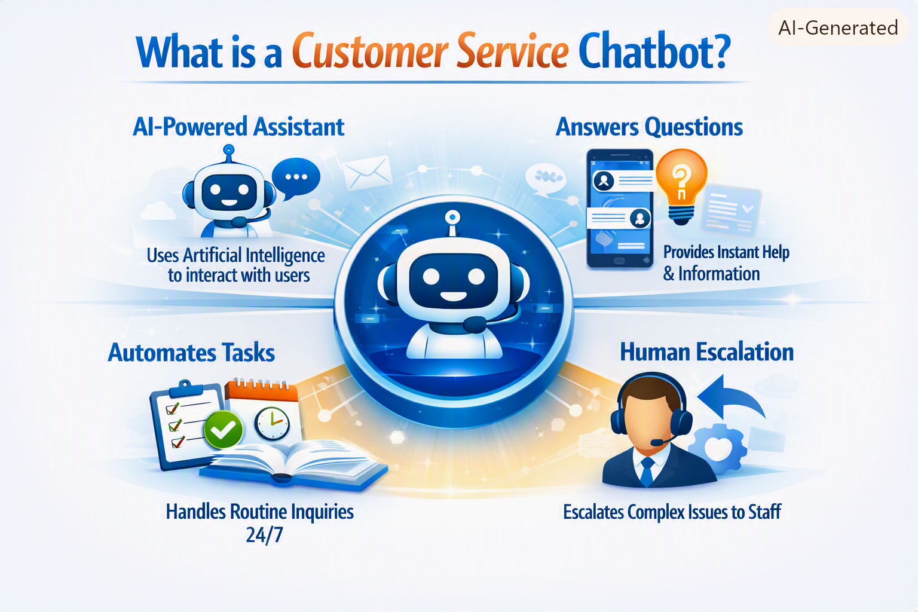
What is a Customer Service ChatBot?
Notes:
🤖 AI‑Powered Assistant — interacts intelligently with users
💬 Answers Questions — provides instant help and information
📋 Automates Tasks — handles routine inquiries 24/7
🎧 Human Escalation — routes complex issues to staff

Slide 10
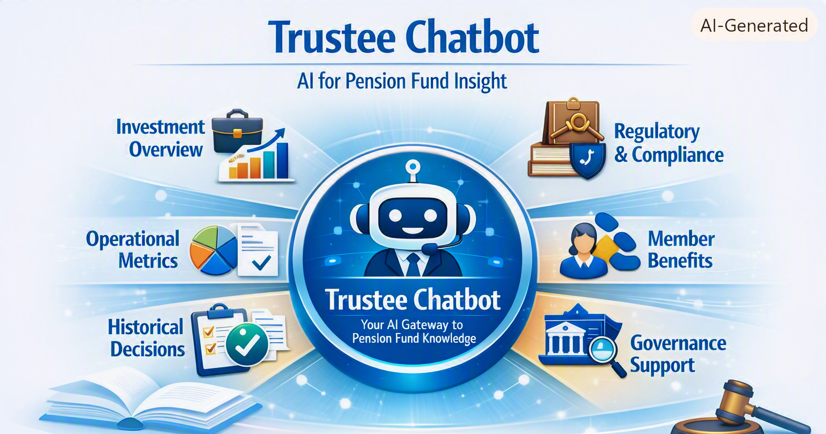

Slide 11
A Trustee Chatbot acts as an intelligent assistant that helps trustees understand the fund’s operations, investments, compliance, and member benefits — transforming complex data into actionable insight and creating an institutional information repository in one place.
What is a Trustee ChatBot?
Notes:
🤖 AI‑Powered Assistant — interacts intelligently with users
💬 Answers Questions — provides instant help and information
📋 Automates Tasks — handles routine inquiries 24/7
🎧 Human Escalation — routes complex issues to staff

Slide 12
Trustee Chatbot in Action
The Trustee Chatbot could serve as a real‑time governance assistant providing trustees with instant access to historical decisions, investment data, compliance updates, and member benefit details during meetings.

Slide 13
Trustee Chatbot in Action
“Summarize last quarter’s investment performance.”
“List compliance updates since our last meeting.”
“Retrieve prior motions on COLA adjustments.”
“What is current member benefit formula for Tier 3.”

Slide 14
Trustee Chatbot in Action
Instant Context – Reduces time spent searching documents.
Historical Recall – Accesses prior board actions and precedents.
Decision Confidence – Provides data‑anchored insights for votes.
Compliance Assurance – Flags statutory or policy implications.
Collaboration – Keeps trustees, staff, and advisors aligned.

Slide 15

Create a chart that compares the retirement benefits from the San Antonio,
El Paso, Houston, Austin and Dallas police pension systems
City | Retirement Eligibility | Benefit Formula | COLA Policy | Employee Contribution | Employer Contribution | Notes
San Antonio | 20 years of service | 3.0% ×yrs of service × final average salary | Ad hoc based on fund performance | 12.32% | 24.64% | Strong funding ratio; recent COLA adjustments tied to actuarial surplus
El Paso | 20 years of service | 2.75% ×yrs of service × final average salary | Periodic review by Board | 13.89% | 27.78% | Smaller fund size; conservative investment mix
Houston | 20 years or age 55 with 10 years | 2.8% × yrs of service × final average salary | Annual CPI‑linked COLA (max 2%) | 10.25% | 31.00% | Hybrid plan after 2017 reform; strong governance Oversight
Austin | 23 years of service | 3.0% × yrs of service × final average Salary | Ad hoc based on fund returns | 13.00% | 21.63% | Moderate funding; recent benefit enhancements
Dallas | 25 years of service or age 58 with 10 years | 2.75% × yrs of service × final average salary | Suspended COLA since 2017 reform | 13.50% | 27.50% | Under recovery plan after prior funding crisis

Slide 16
AI ChatBots need structured, rule‑anchored JSON to understand benefit formulas, eligibility, COLA rules, contributions, and plan history.
How Does Your Pension Fund Take the Next Step?
Notes:
🤖 AI‑Powered Assistant — interacts intelligently with users
💬 Answers Questions — provides instant help and information
📋 Automates Tasks — handles routine inquiries 24/7
🎧 Human Escalation — routes complex issues to staff

Slide 17
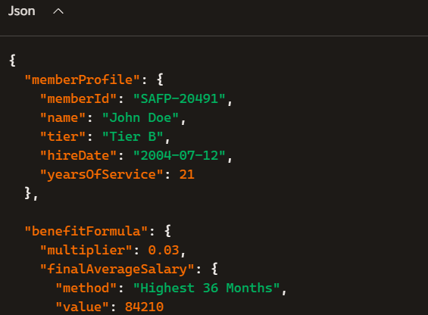
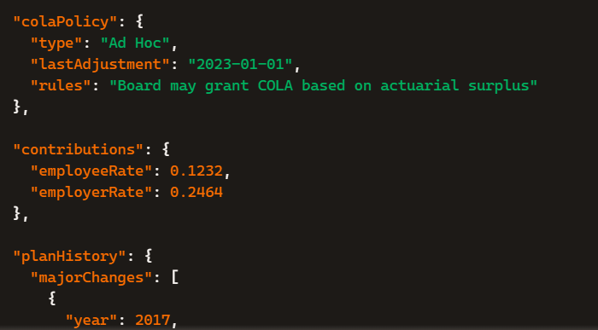
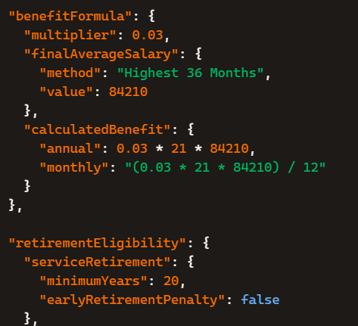
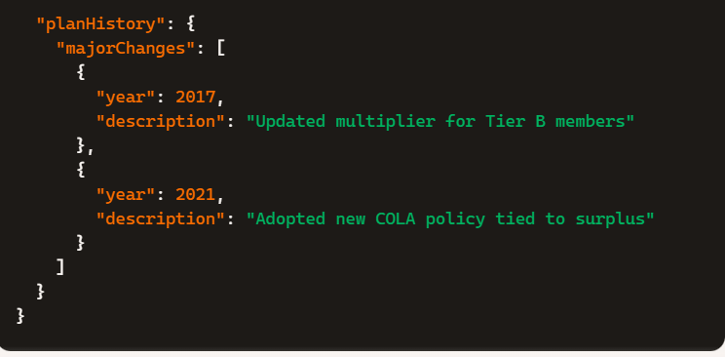

Slide 18
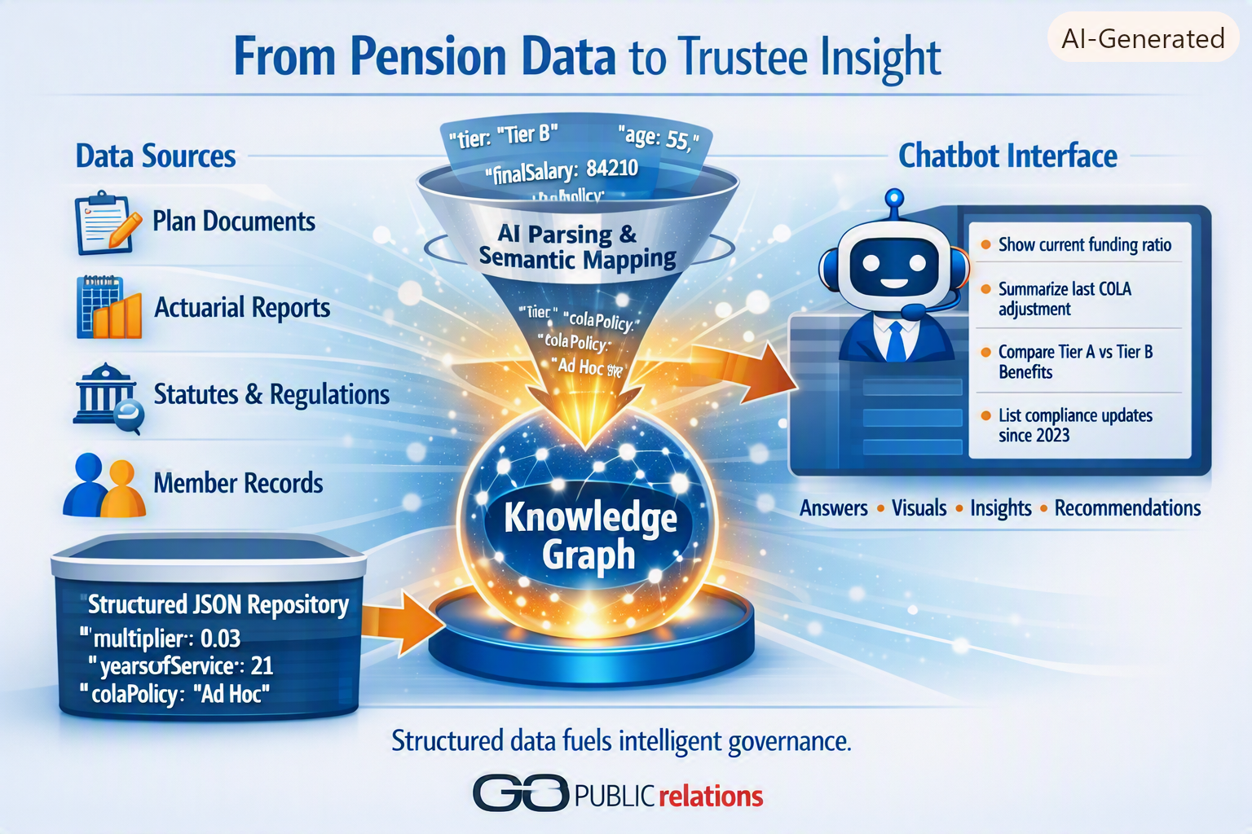

Slide 20
